Slide 1




Effective Use of Primary Sources for Remote Teaching and Learning
Dr. Elizabeth R. Osborn @engagingcongres
Education Director, Indiana University Center on Representative Government
Jennifer Jolley, NBCT @jjolleymsd
Palm Bay Magnet High School, Melbourne, Florida
For more information, contact Dr. Elizabeth R. Osborn at eosborn@iu.edu
Notes:
Don’t need the award logo here since not primarily an EC webinar. Maybe should do the SML logo? Include date? June 25, 2020

Slide 2

Workshop Objectives
Discover free primary source materials in the Library of Congress digital collections
Explore the Library of Congress Teaching with Primary Sources (TPS) program and analysis tools
Analyze primary sources with activities from the free LOC civics interactive Engaging Congress
Notes:
Please improve. Add some graphic? Topic is remote teaching and learning with primary sources. Computer? Computer as a chalkboard? Phone?

Slide 3

LOC Resources and search strategies
Homepage
www.loc.gov
Digital Collections
www.loc.gov/collections
Congress and lawmaking
www.congress.gov
TPS teachers pages
www.loc.gov/teachers
Newspapers and Recommended Topics chroniclingamerica.loc.gov
Web guides
www.loc.gov/rr/program/bib/bibguide.html
Notes:
Please improve. Add some graphic? Topic is remote teaching and learning with primary sources. Computer? Computer as a chalkboard? Phone?

Slide 4
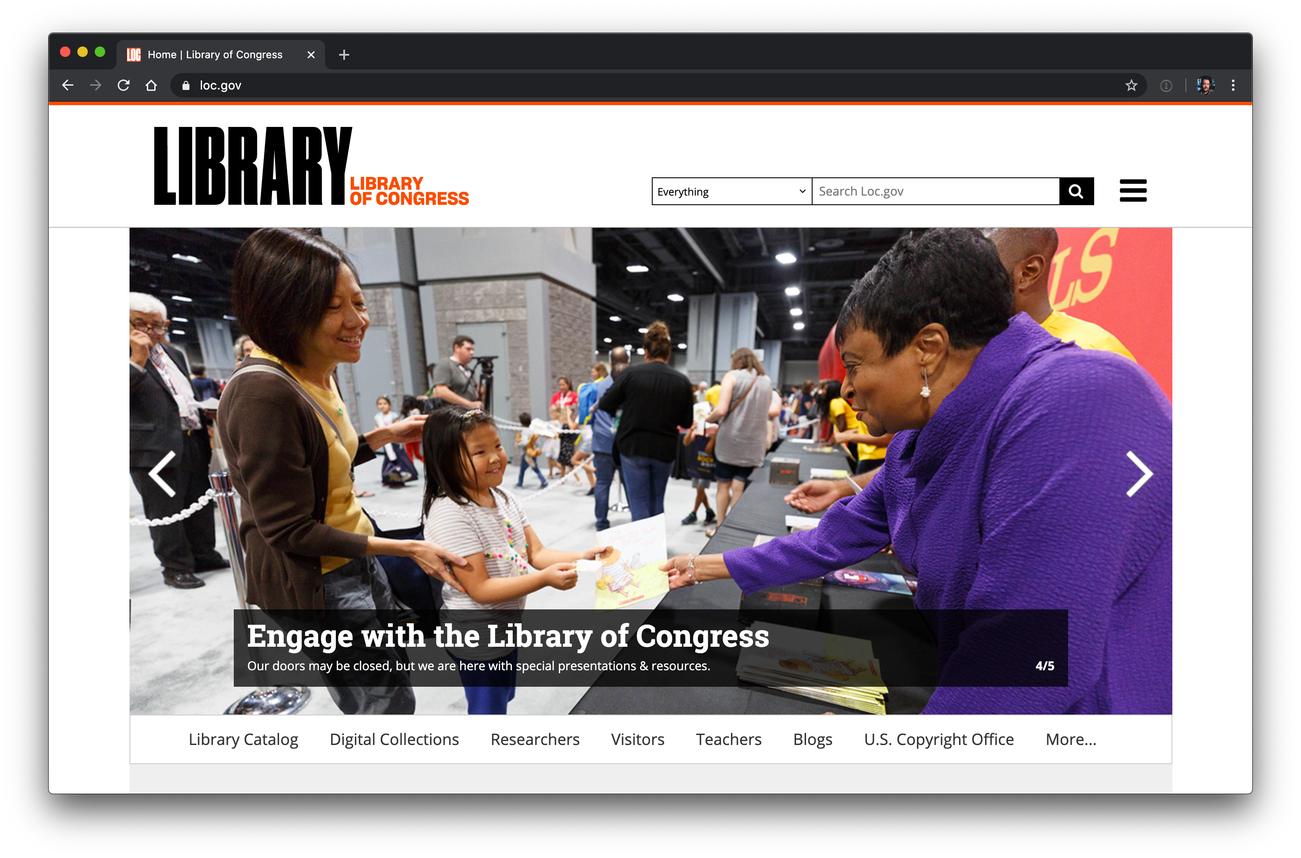
Library of Congress loc.gov
Notes:
Free to use and resuse, blogs, exhibits, trending, research centers—right side kids and families, hamburger on upper right

Slide 5
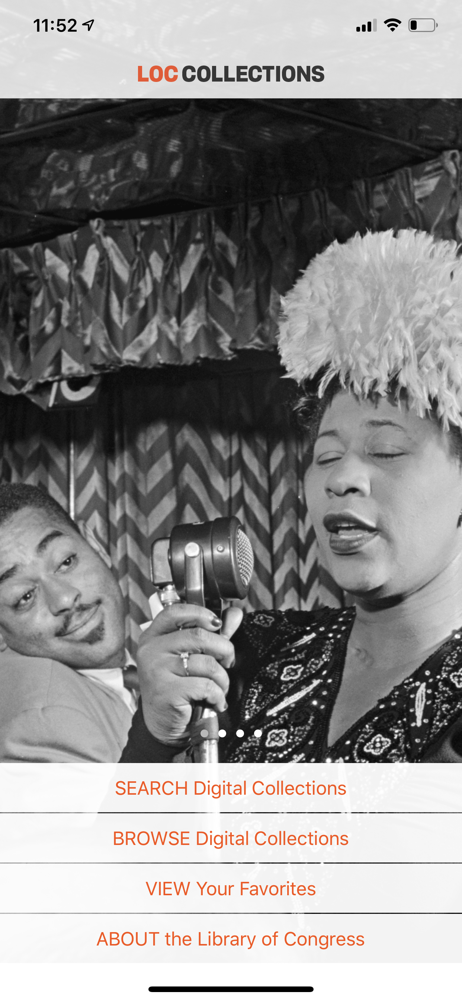
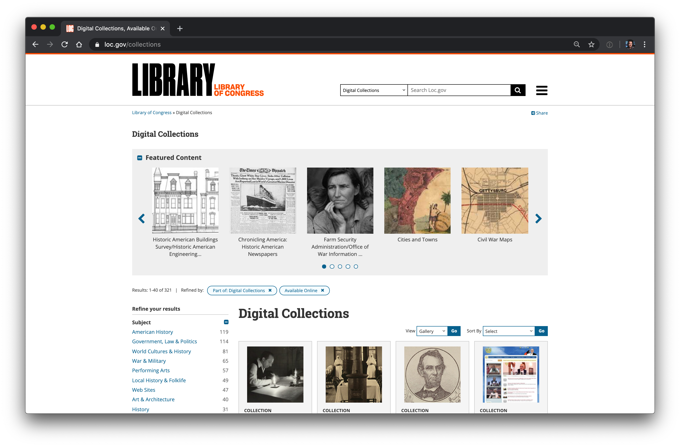
Digital Collections loc.gov/collections
Notes:
Split screen? Digital collections home page and the new app on the other side?

Slide 6
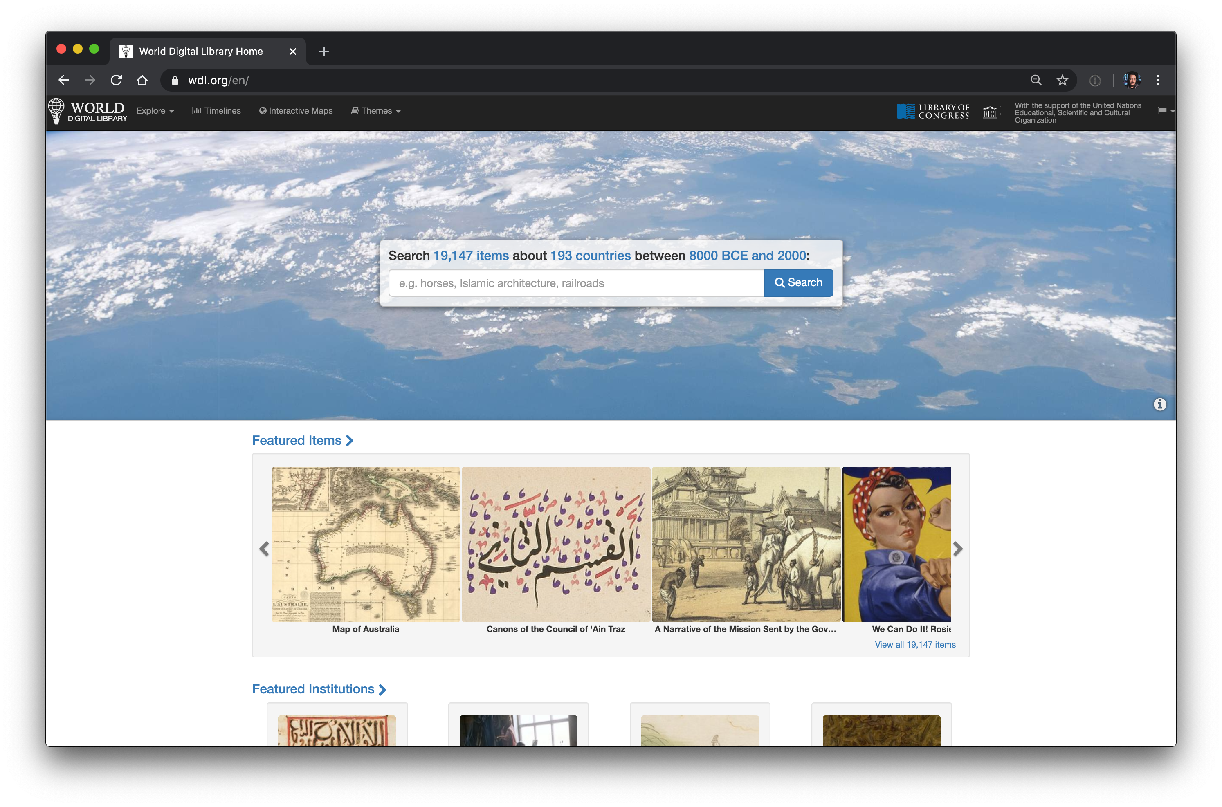
World Digital Library wdl.org
Notes:
Free to use and resuse, blogs, exhibits, trending, research centers—right side kids and families, hamburger on upper right

Slide 7
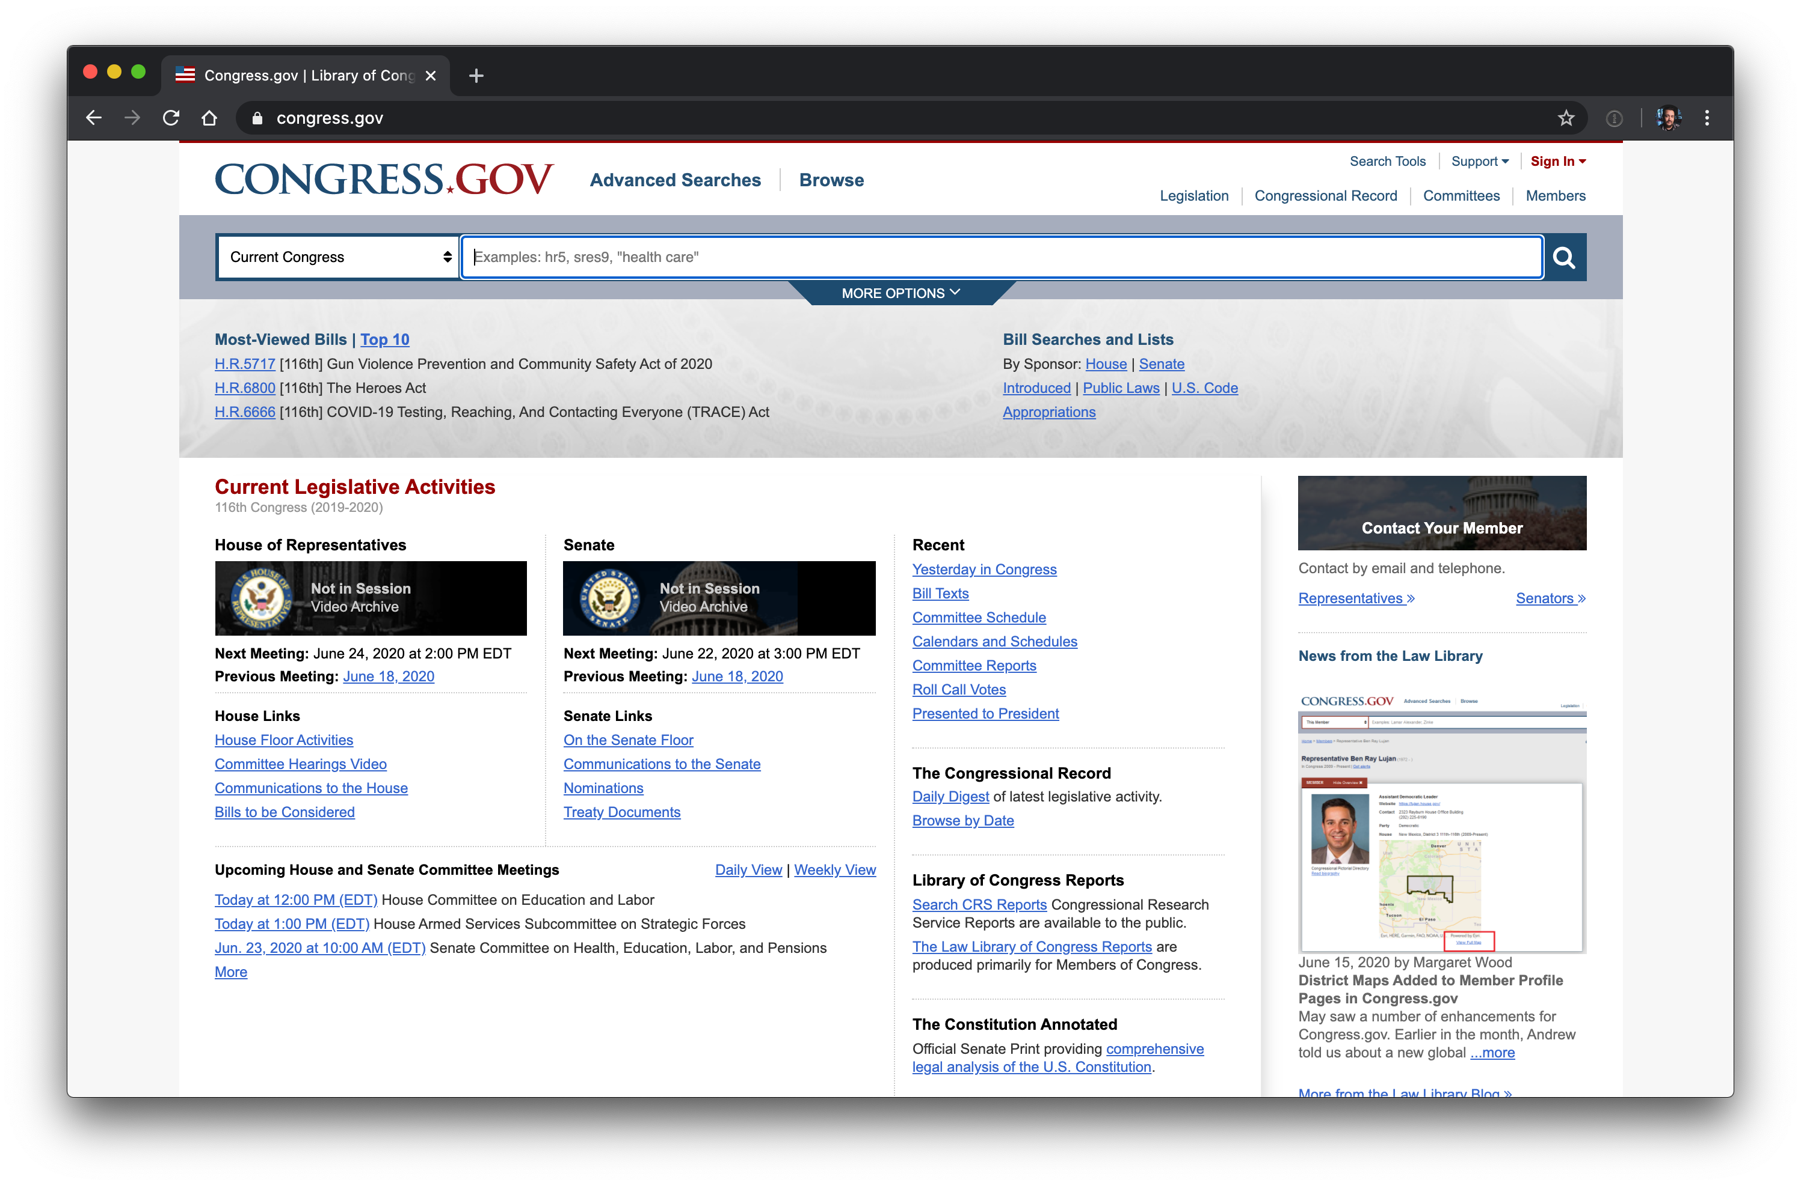
Congress and Lawmaking congress.gov
Notes:
Arrows on most watched legislation, search for your delegation, videos on far right

Slide 8
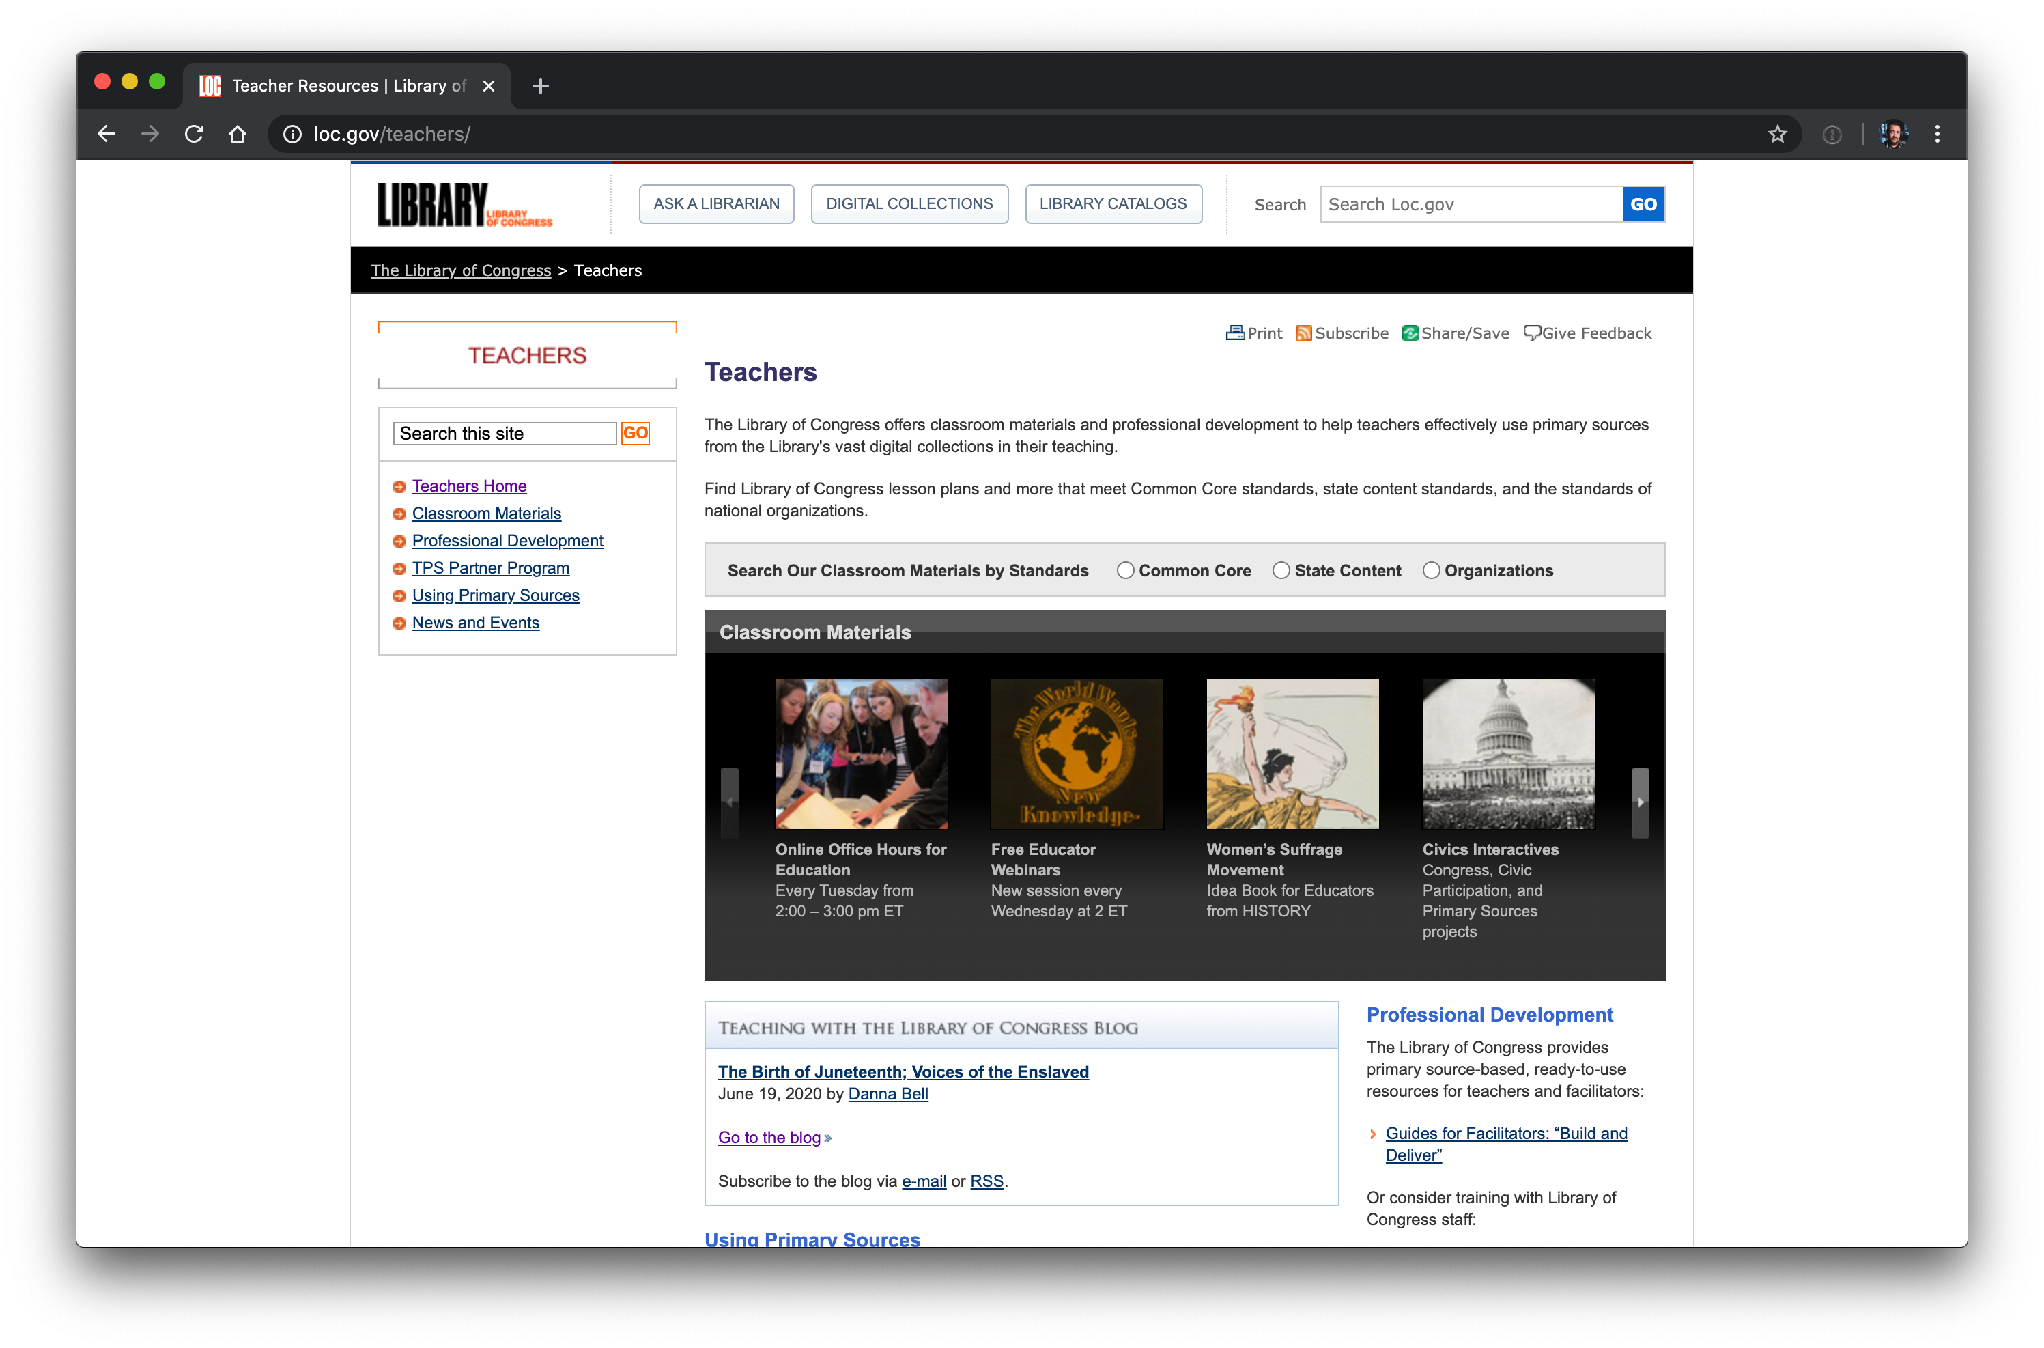
TPS Teacher Pages loc.gov/teachers

Slide 9
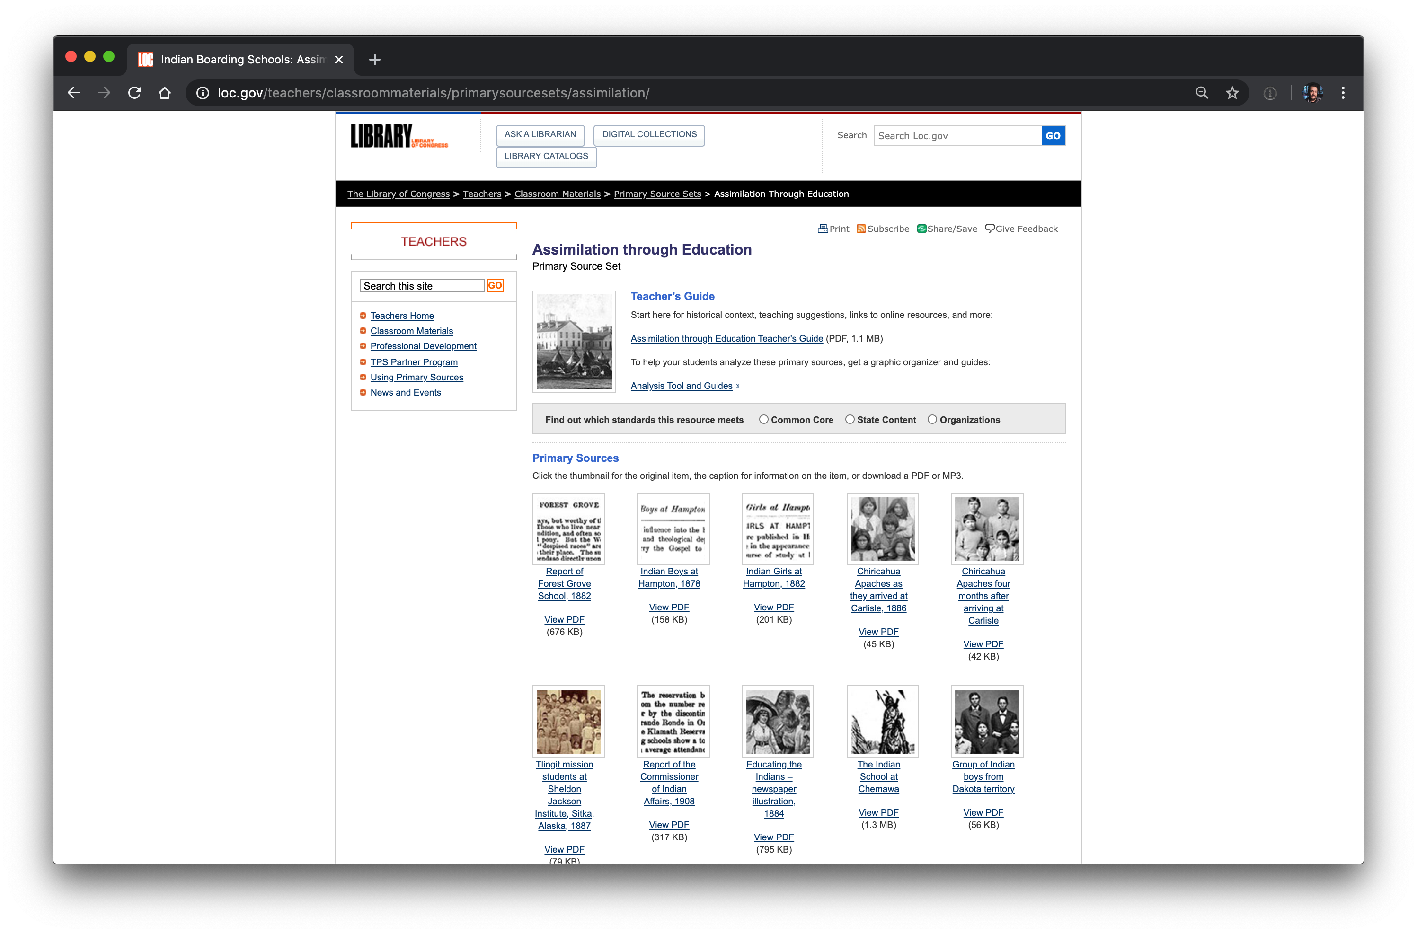
Classroom Materials: PS sets

Slide 10

Let’s go live

Slide 11
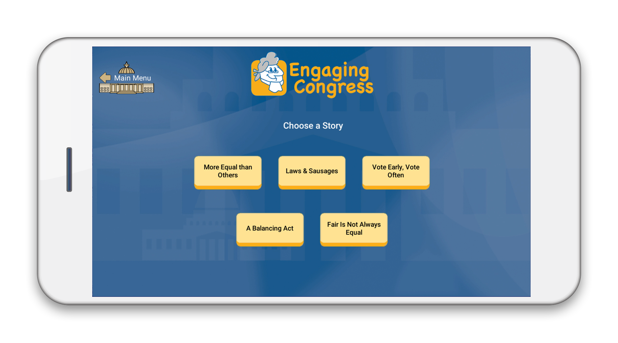

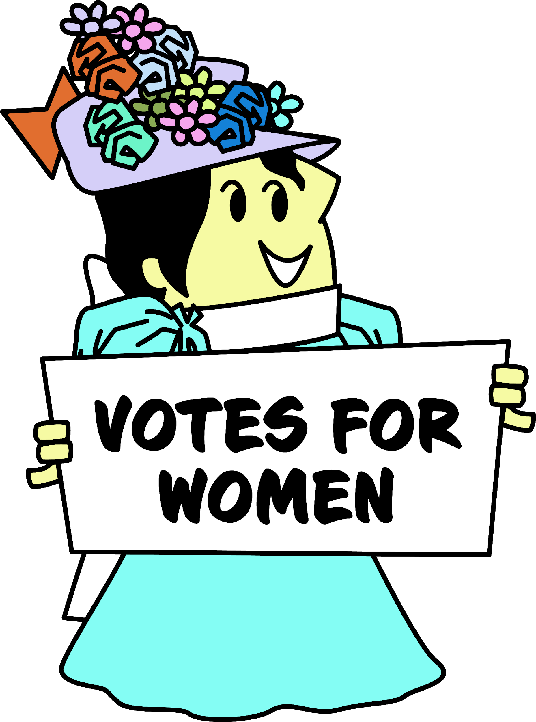
A FREE, fun, interactive civics game using primary sources to explore how government works.
FORMATTED for Chromebooks, computers, tablets, and mobile devices
TARGETED for grades 6 through 12
DESIGNED with Library of Congress sources using inquiry-based analysis
Notes:
Jen introducs EC as means of analyzing primary sources remotely or in class

Slide 12

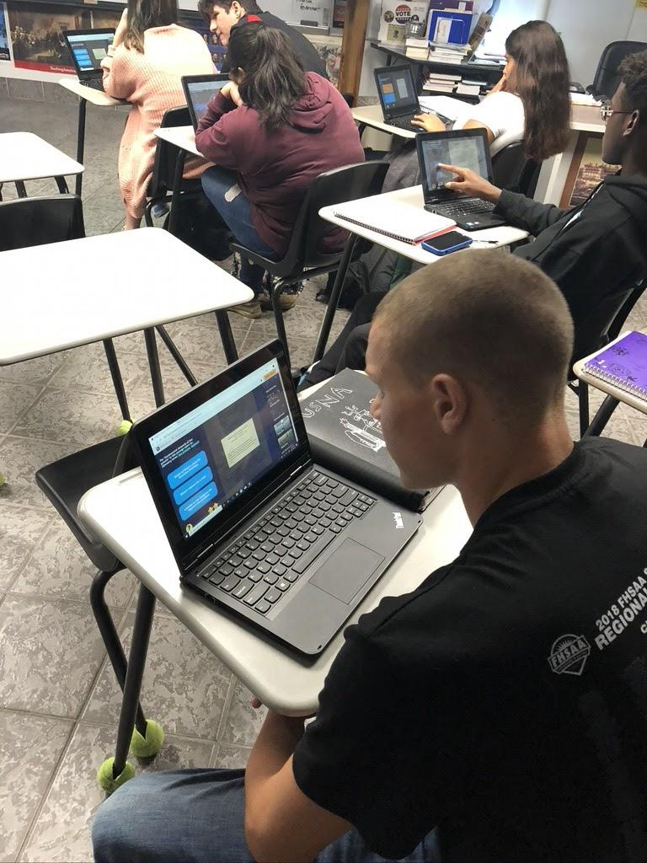
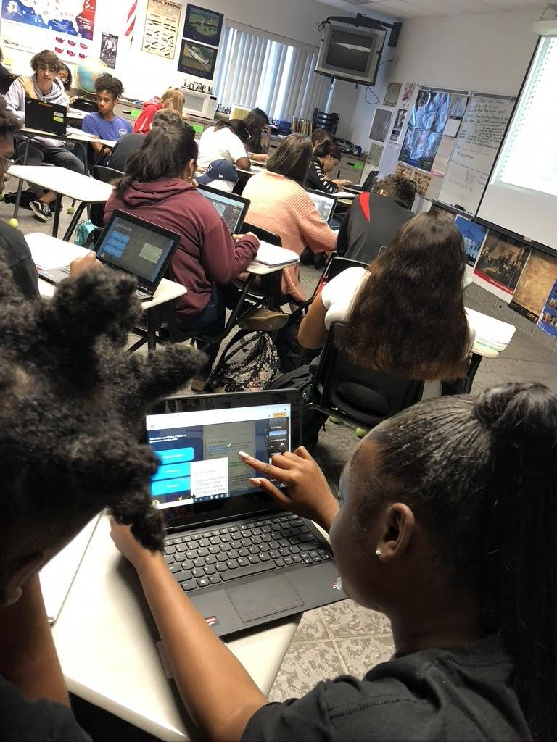
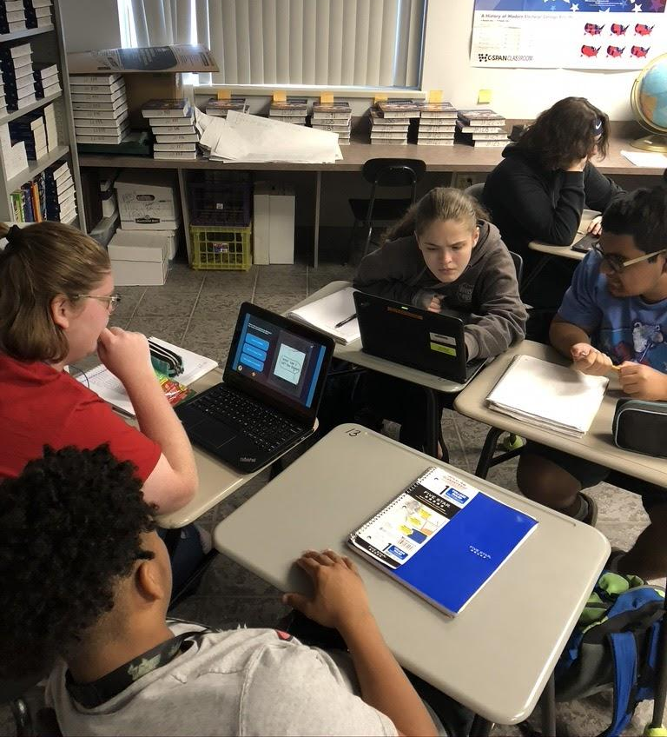
Notes:
Ms. Jolley’s students . Jen describe her assignment while this slide showing

Slide 13
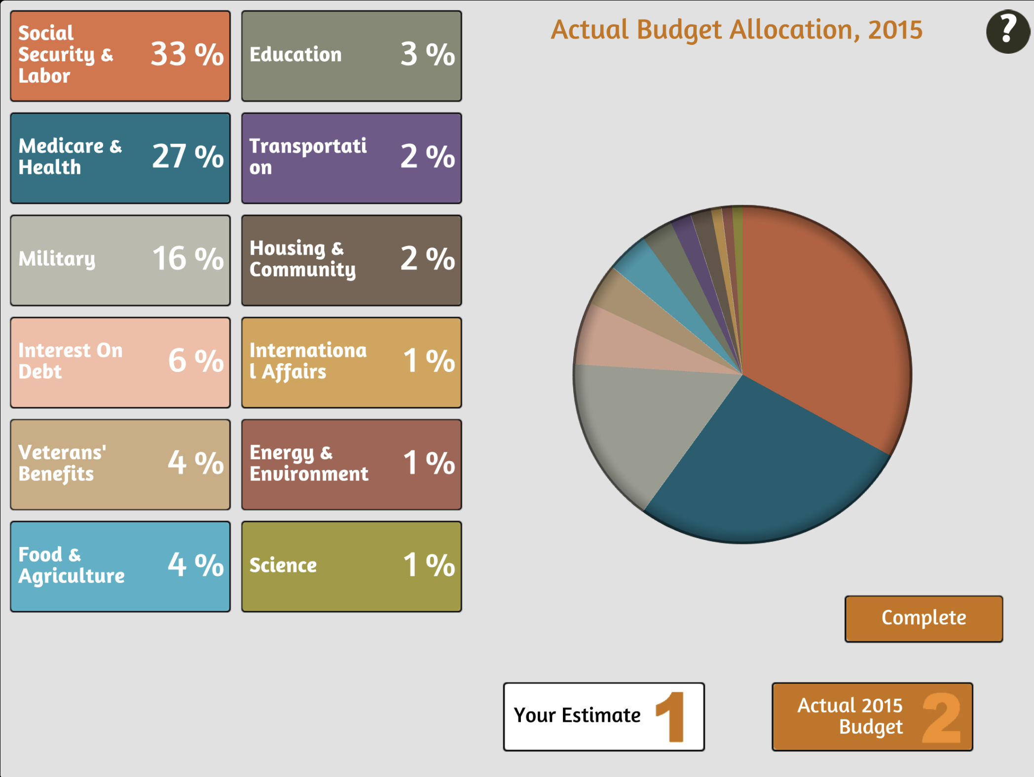
Classroom Testimonial
While playing the game Engaging Congress on my phone I learned quite a few different things. For one it amazed me how much money was actually being spent yearly on all different things such as medicare, the military, food and agriculture. In 2015 alone there was $3.8 trillion spent alone. I also learned that the people responsible for throwing the tea overboard at the Boston Tea Party were protestors just as Native Americans. Did you know that 47% of the federal money comes from individual income taxes? Because I did not know that before today. I really enjoyed this game/ assignment a lot. It gave me a lot of interesting and important information.
--Grant, 11th grade, Melbourne, FL
Notes:
Right side is Jen’s description of the assignment which she said during previous slide. I would like slide to have the testimonial but maybe on the other side the image from EC with budget game

Slide 14
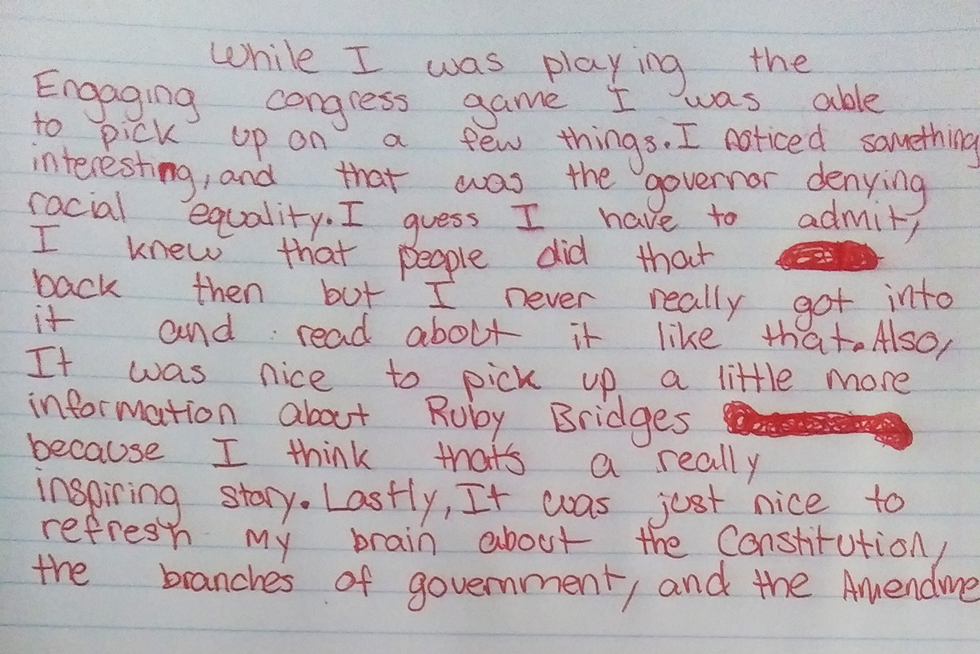
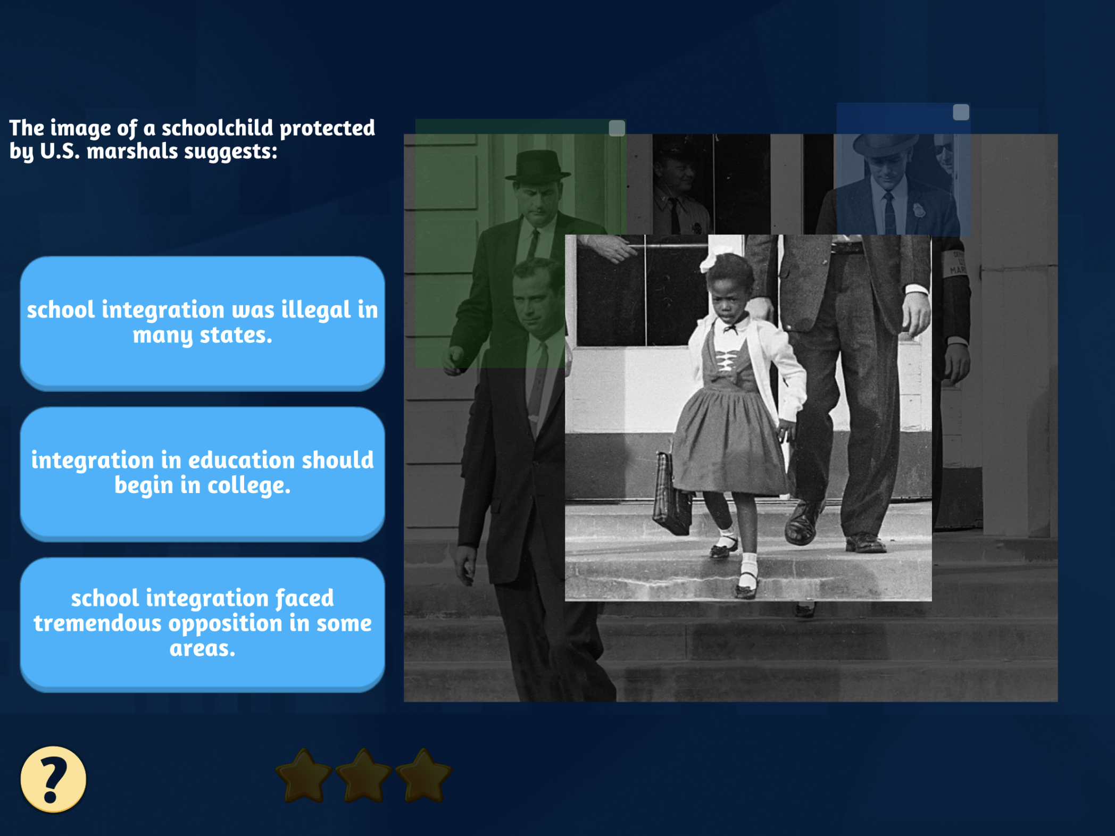
Classroom Testimonial
Marcus, 11th grade, Melbourne, FL
Notes:
Here testimonial and then George Wallace blocking entrance to University of Alabama or Ruby Bridges paired with hand written

Slide 15
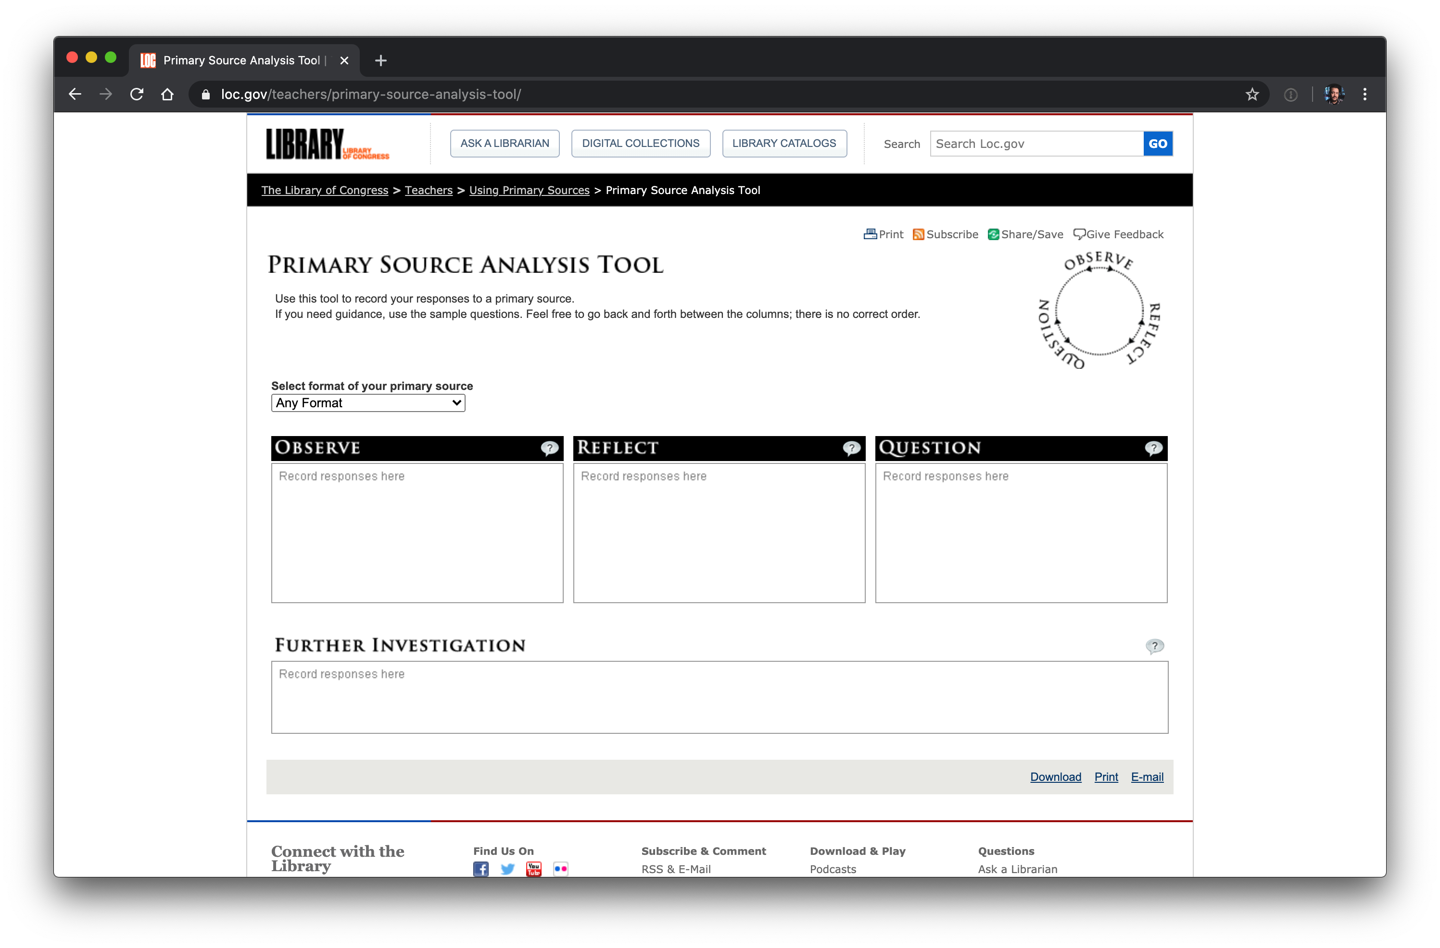
www.loc.gov/teachers/primary-source-analysis-tool/
Notes:
Jen explains how this analysis tool is just one of many available out there for you to use

Slide 16
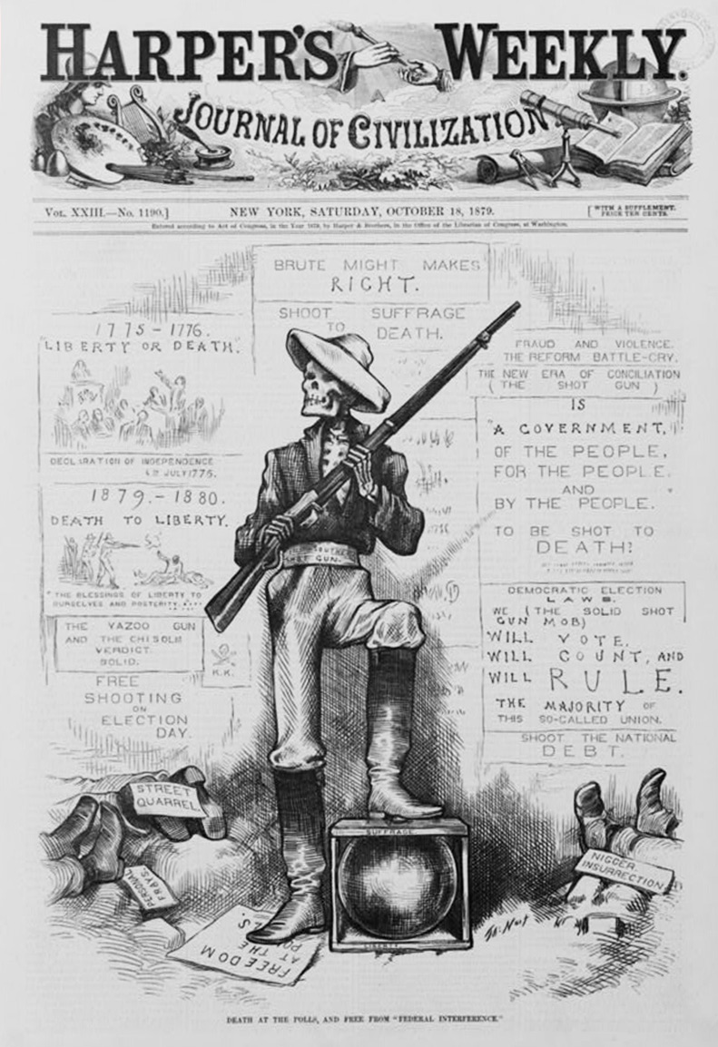
Image Analysis
In the chat box, please share an observation, reflection, or question about this image.
Notes:
I will ask teachers submit analysis of this image—death at the polls. Then show EC slides, then student testimonial

Slide 17
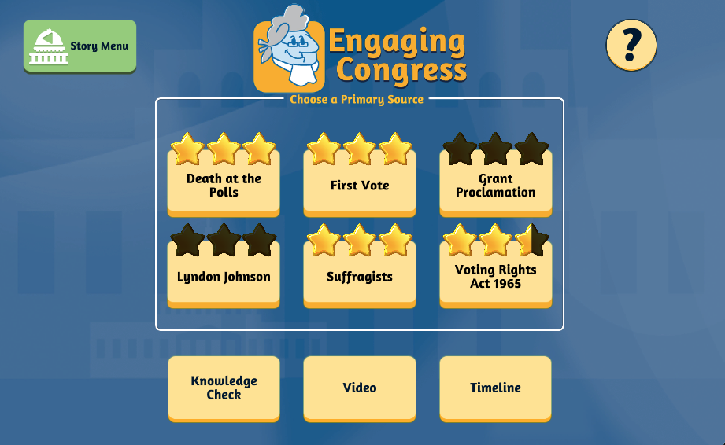
Vote Early, Vote Often
Notes:
Jen talks about teaching a voting unit. Covers topics about voting from Reconstruction to present. Variety of primary sources including photos, text and magazine covers.

Slide 18
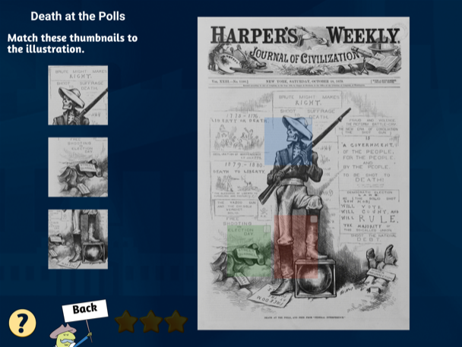
Notes:
I could explain what they are seeing in the slide.

Slide 19
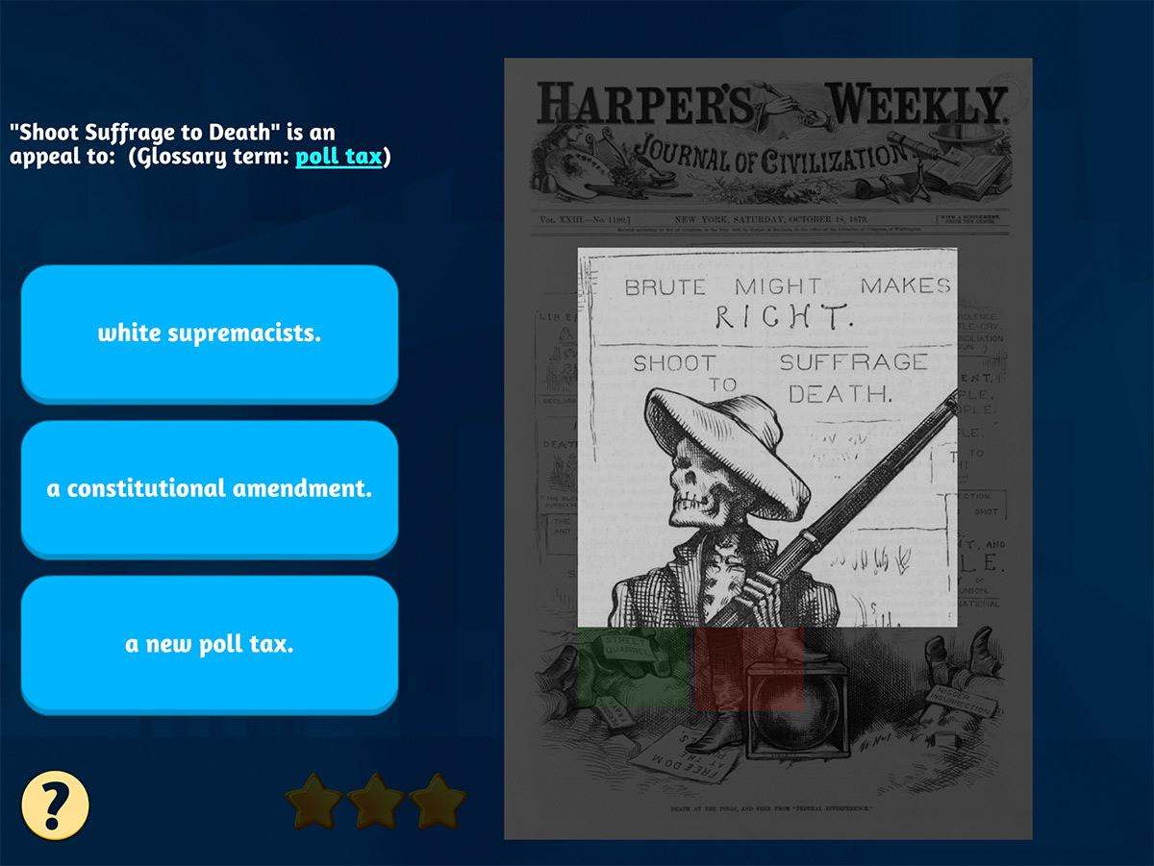

Slide 20
2020 Student Testimonial
The story I played during Engaging Congress was “Vote Early, Vote Often”. While playing one of the puzzles a surprising bit of information I learned is that even today certain groups are still restricted from voting. While these laws are being tested in courts, one would think that the combination of the 14th, 15th, and 19th amendments would have prevented this type of behavior. Another thing I learned was the white supremacists would attempt to do all kinds of things to prevent African Americans from voting. While laws were put in place with the hidden intentions of preventing African Americans from voting, minority voters went through all kinds of abuse and obstacles in order to vote. They were given wrong information, literacy tests, charged a poll tax, and threatened with physical abuse or even death if they wanted to vote. Despite having all kinds of laws and constitutional amendments at the time to prevent this kind of behavior white supremacists did everything in their power to prevent minorities from practicing their rights as citizens.
–Riazz, 11th grade student, Melbourne, FL
Notes:
Jen then connects student testimonial to analysis we just did This is the Death at the Polls image. Skeleton with the gun. Watermark text into the testimonial?

Slide 21
Vote Early, Vote Often
Notes:
Jen talks about teaching a voting unit. Covers topics about voting from Reconstruction to present. Variety of primary sources including photos, text and magazine covers.

Slide 22
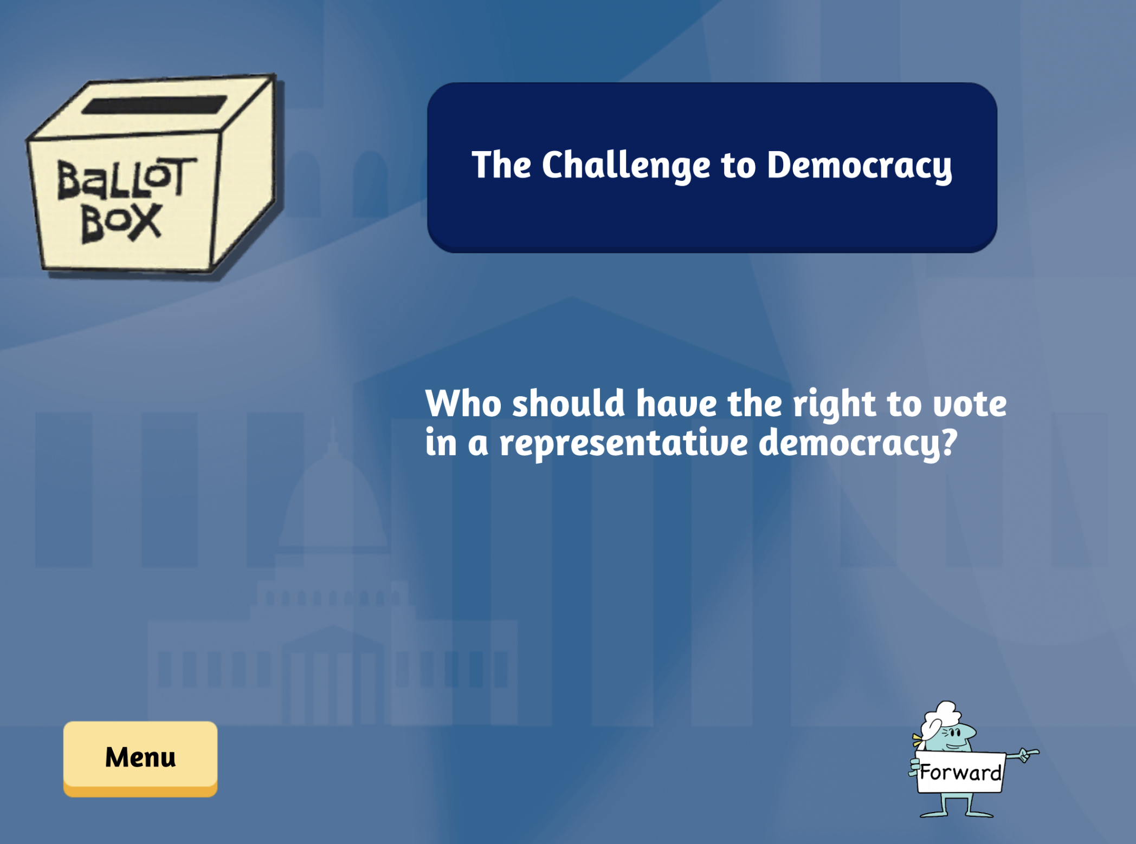
Vote Early, Vote Often

Slide 23
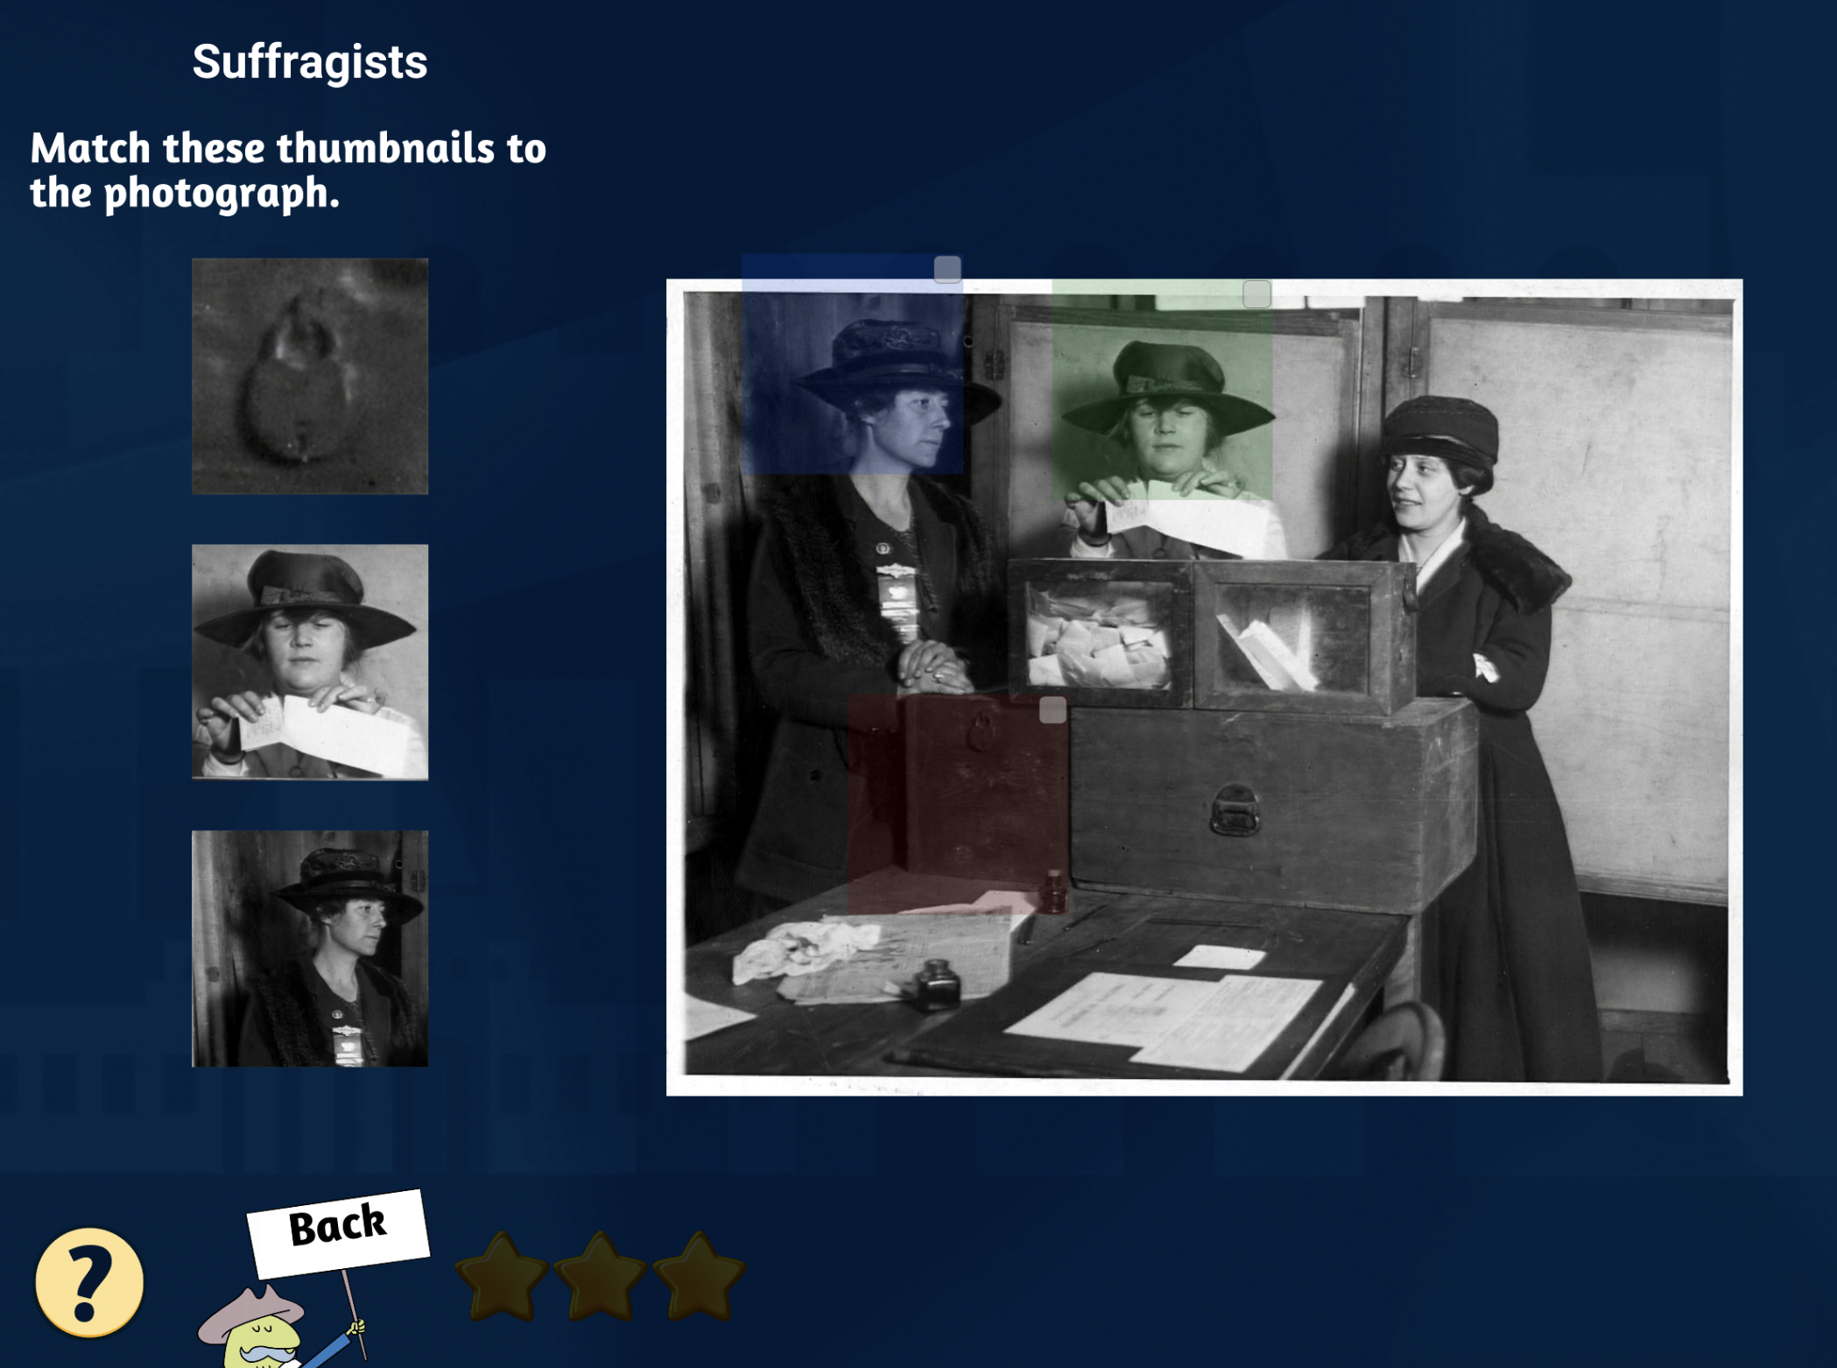
Vote Early, Vote Often

Slide 24
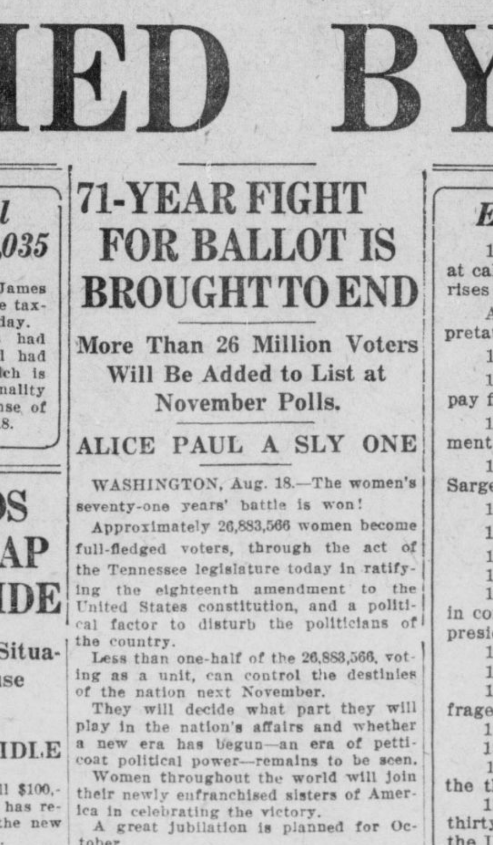
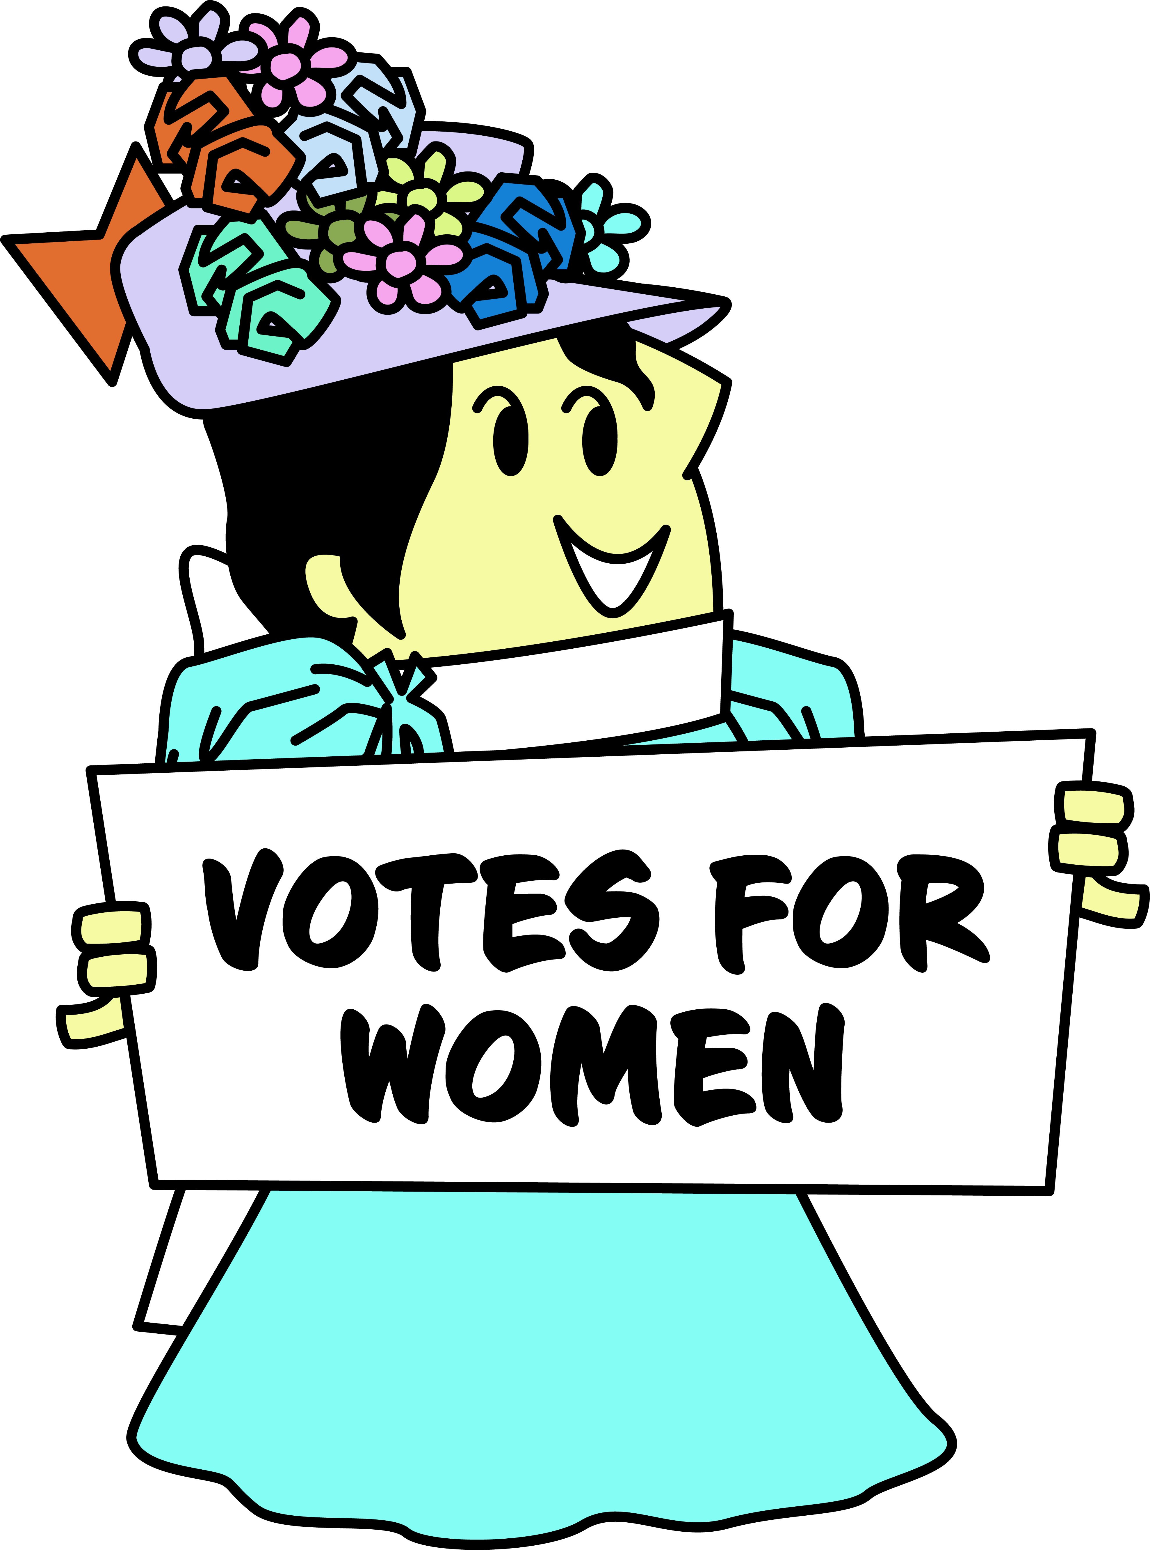
Nineteenth Amendment • August 18, 1920
100th Anniversary this year!
Indiana daily times. [volume] (Indianapolis [Ind.]), 18 Aug. 1920. Chronicling America: Historic American Newspapers. Lib. of Congress.
https://chroniclingamerica.loc.gov/lccn/sn85047611/1920-08-18/ed-1/seq-1/
Notes:
https://chroniclingamerica.loc.gov/lccn/sn85047611/1920-08-18/ed-1/seq-1/ Jen explains one way to extend this lesson is through a search of newspapers. Chronicling America lets you search by state and date range. Could also search the photo collection, or the women’s suffrage collection and exhibit.
I

Slide 25
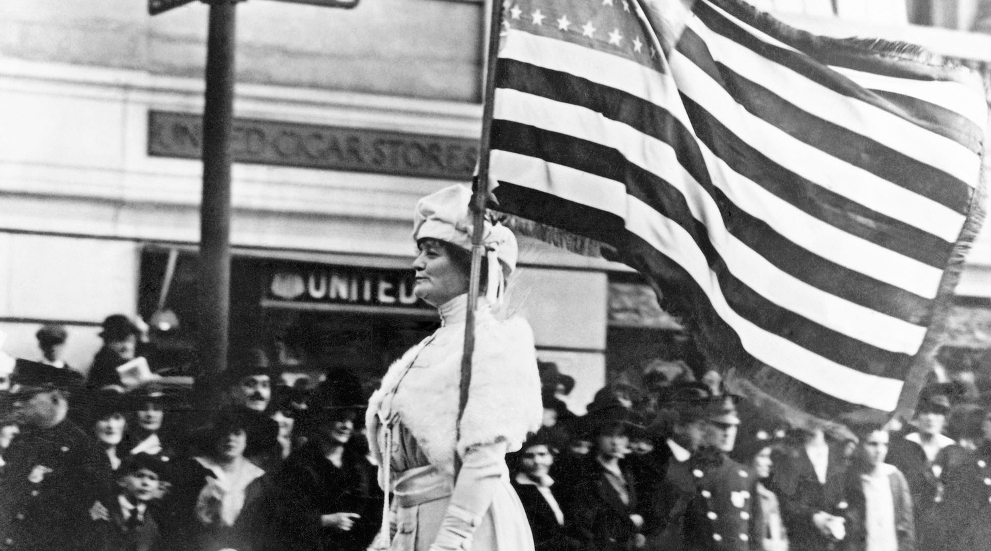
Woman Suffrage
19th Amendment Turns 100!
August 18, 1920
https://bit.ly/women2020Suffrage
Notes:
https://bit.ly/women2020Suffrage Jen has a huge document of resources. Maybe another suffragette behind list that is in the resource section

Slide 26
Vote Early, Vote Often
Notes:
Jen talks about teaching a voting unit. Covers topics about voting from Reconstruction to present. Variety of primary sources including photos, text and magazine covers.

Slide 27
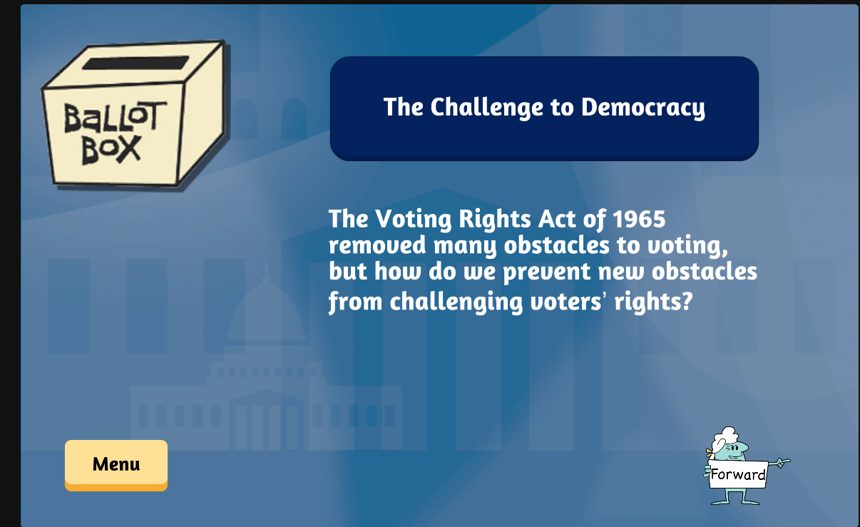
Notes:
Each of the primary sources has a compelling question

Slide 28
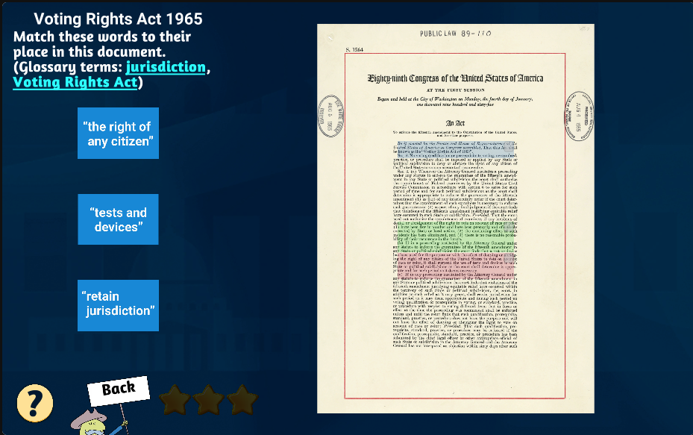
Notes:
Vocabulary words. Text at varying levels. This would be for higher grades or levels—reading actual legislation

Slide 29
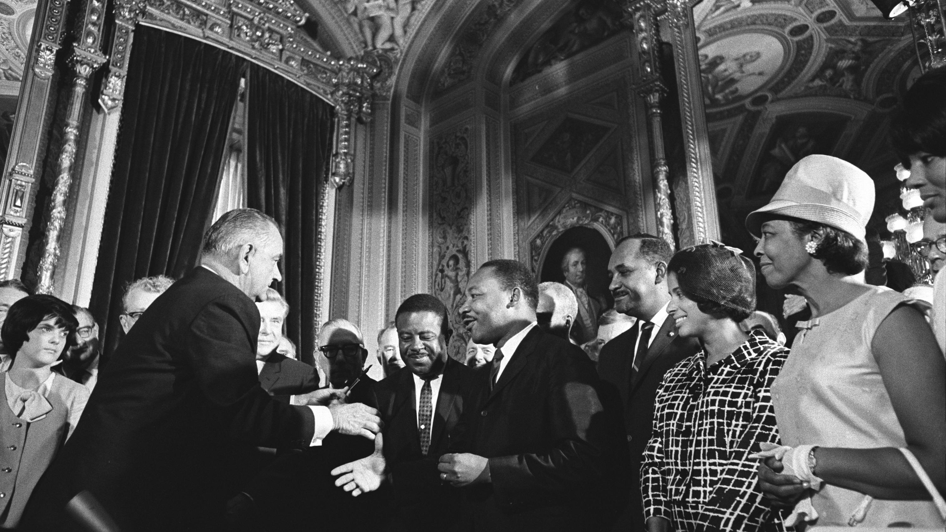
Dive Deeper? More Rigor?
Voting Rights Act of 1965 (August 6, 1965)
55th anniversary this year!
TPS Teachers Network
https://tpsteachersnetwork.org/album/26099-voting-rights-act-of-1965
Notes:
Ideas from Jen on what should be here How TPS network is repository of teaching ideas from likeminded teachers. FB for Primary source geeks. Images of TPS teachers network then reference resources sheet.

Slide 30
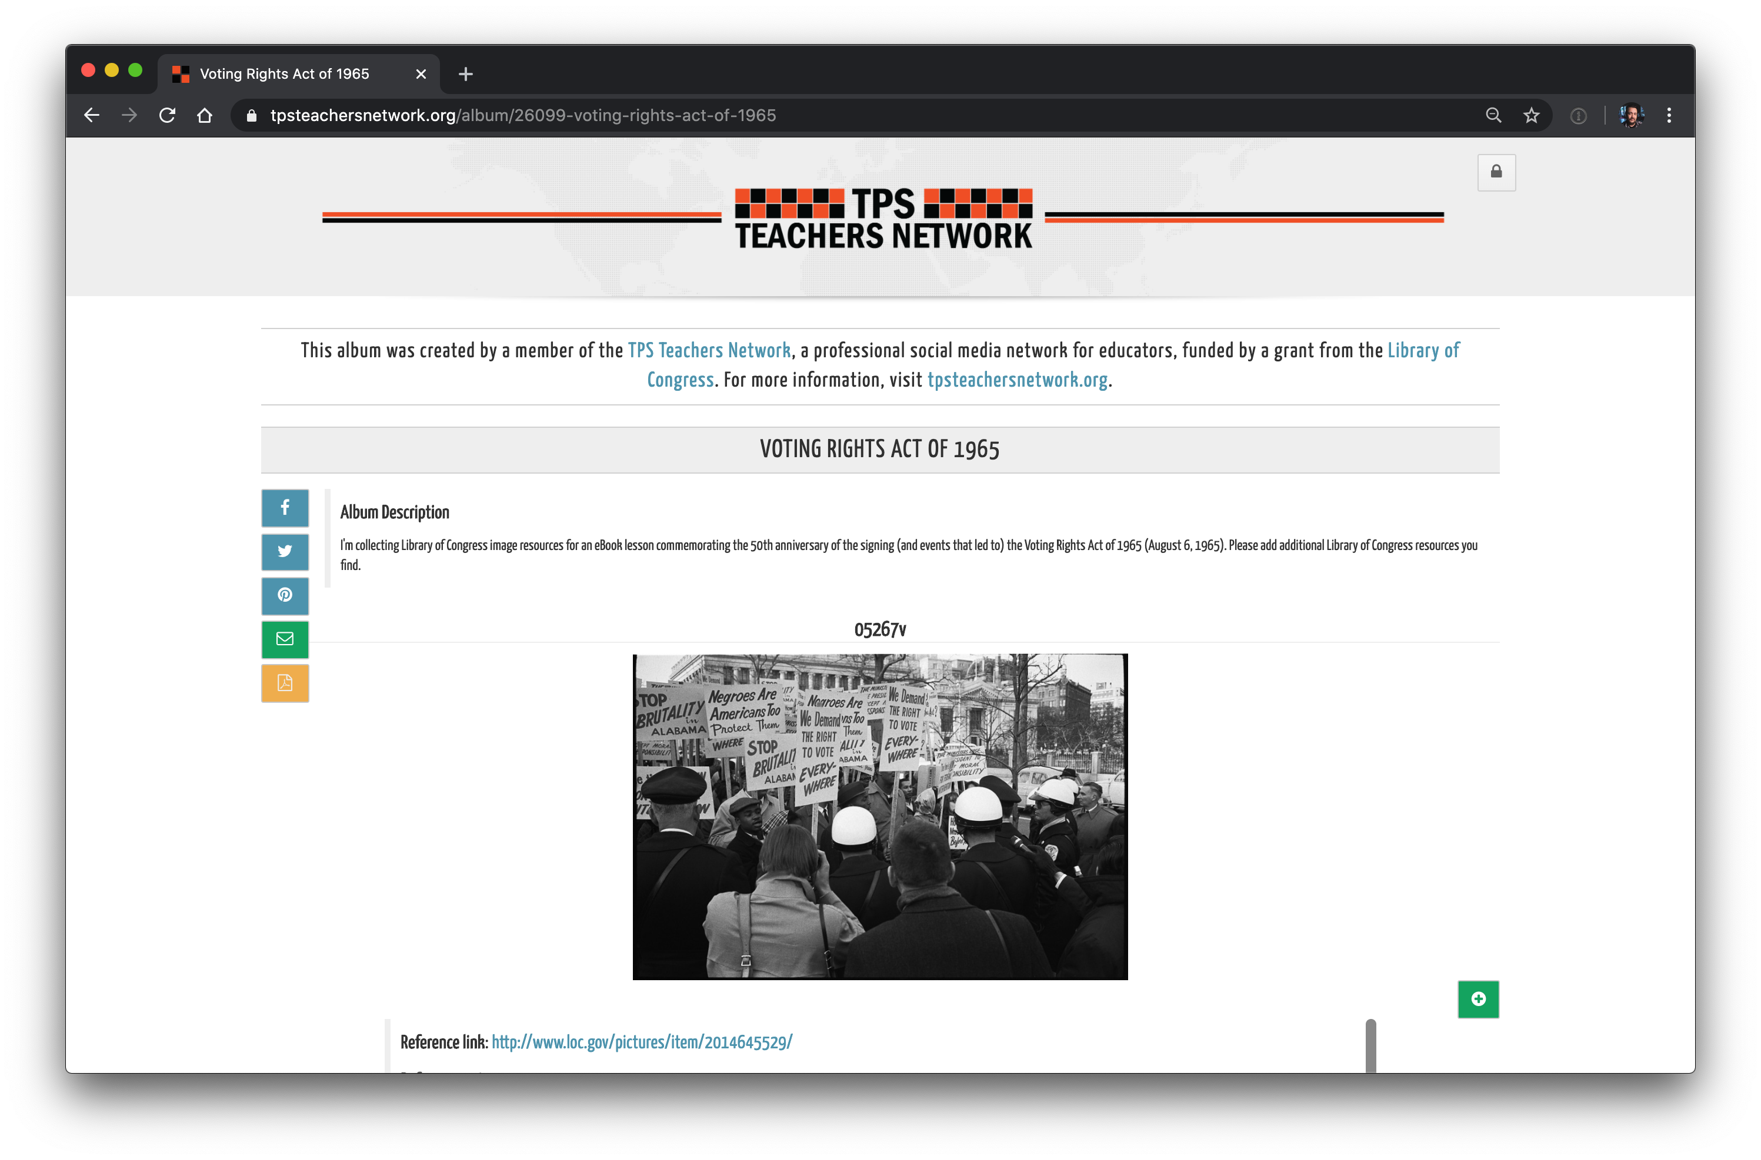
TPS Teachers Network tpsteachersnetwork.org/album/26099-voting-rights-act-of-1965

Slide 31
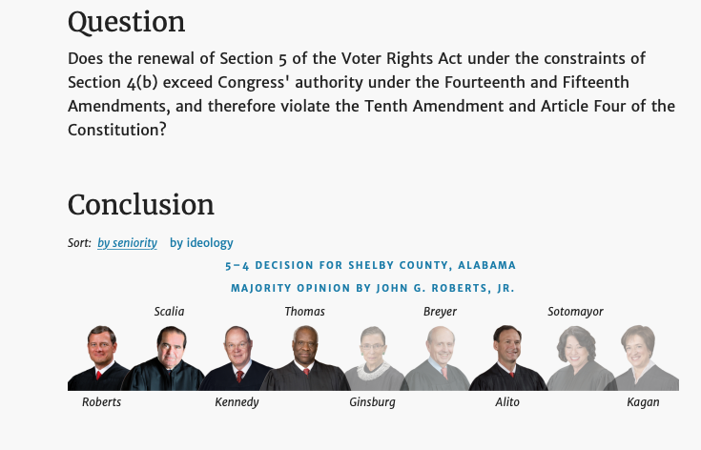
Shelby County v. Holder 2013
Shelby County v. Holder (2013) https://www.oyez.org/cases/2012/12-96/
Notes:
Shelby County v. Holder (2013) https://www.oyez.org/cases/2012/12-96/

Slide 32
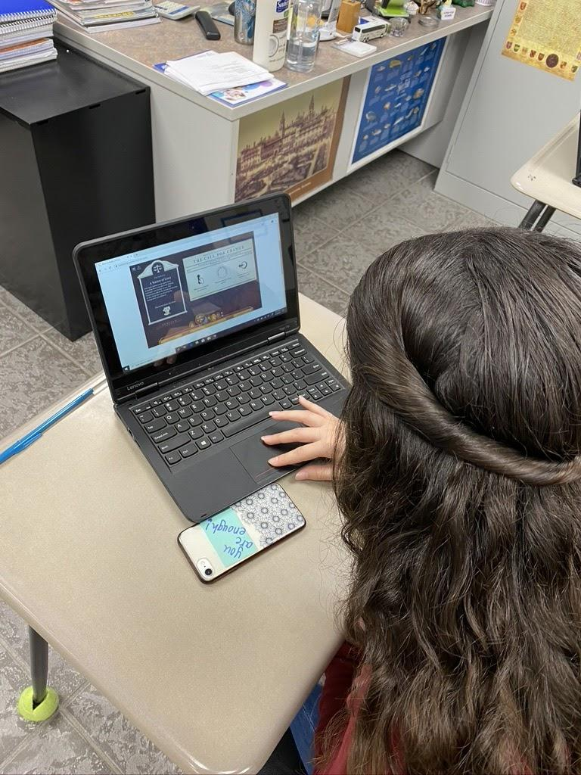
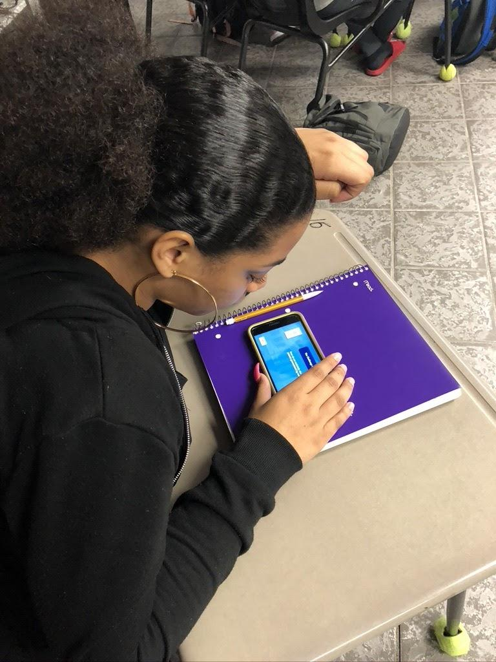
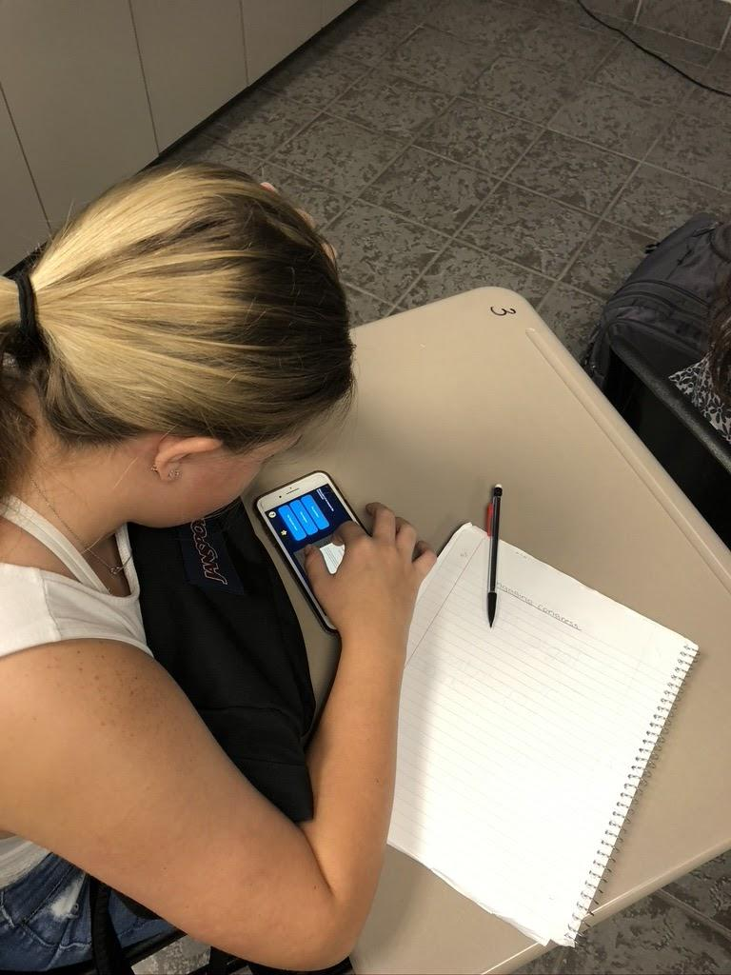
Notes:
Ms. Jolley’s students

Slide 33
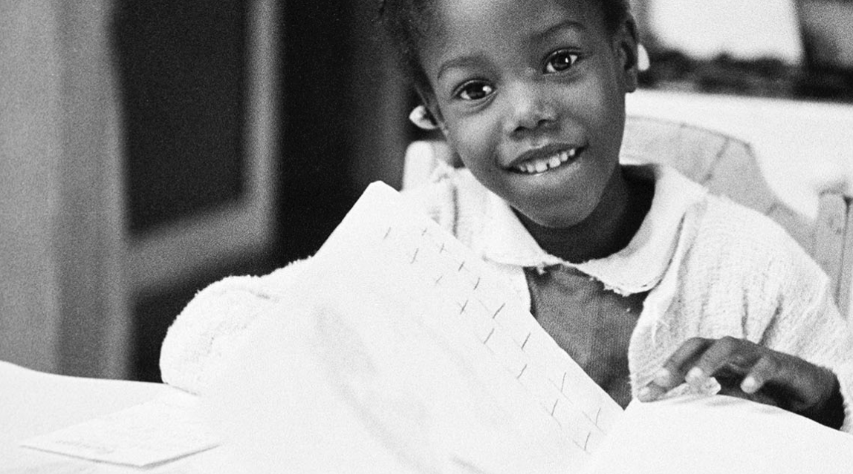
Classroom Testimonial
This game showed history as a collective whole the final map shows the dates ranging from the early 1700’s till the late 90’s of times in which fairness was sought but equality was not met. I love how they spread the information out rather than using one specific time period it really tied together main points in history to make a statement to learn from “ fair is not equal”. Some examples of events in the game were marriage rights showing gender and race both being a factor in marriage under our constitution. Additionally there were powerful images of Scenes such as ruby bridges walking out of a school showing not only equal rights movements for colored people but the tension built in the picture as well you see US Marshals guarding this little girl because her life was truly in danger just for attending school. It's hard to fathom a scene like this when we’re placed into classrooms with such diversity but the reality of it is an order to gain that privilege so many people had to overcome oppression this image in particular was extremely powerful to me. Another was a picture of governor Wallace standing in front of a school not allowing blacks to enter this captures the idea white males Dominated the media we see people standing outside around Wallace all being people of privilege speaking to the media into the minds of the people and teaching them to accept the barriers put in place rather than break them only furthering segregation in this case and showing inequality for minority groups And showing how people of power further oppressed minority groups whether it be race, gender or religion equality has been ideal but never met. From the very beginnings of our country and our own Declaration of Independence Claimed “that all men are created equal, that they are endowed by their Creator with certain unalienable Rights, that among these are Life, Liberty and the pursuit of Happiness. That to secure these rights, Governments are instituted among Men, deriving their just powers from the consent of the governed,” yet time and time again through this lesson we are shown times of oppression and inequality this phrase from the declaration is well known by many students but the lines that follow it are the most important to me and often forgotten “--That whenever any Form of Government becomes destructive of these ends, it is the Right of the People to alter or to abolish it, and to institute new Government, laying its foundation on such principles and organizing its powers in such form, as to them shall seem most likely to effect their Safety and Happiness.” Meaning the power to change our world lies within the people not our government if we sense injustice we must fight for it because obstruction of justice for one is obstruction of justice for all. In a more modern context we still have issues of racism we have come far from the times of slavery the civil rights movements but though under the constitution we are equal or rather in fairness society proves daily of barriers still set in place. We see police brutality and white on black crime in the media consistently there is still progress to be made to reach equality. The biggest lesson learned from this game is though we have made progress through history there will always be progress to be made. A game can start off fair but not be equal in the end just like life. So we as people must learn to strive for equality for society as a whole rather than fairness.
–Tia, 11th grade student, Melbourne, FL
Notes:
Only point of this slide is to demonstrate that student wrote 2 pages when only asked to write 1 paragraph

Slide 34
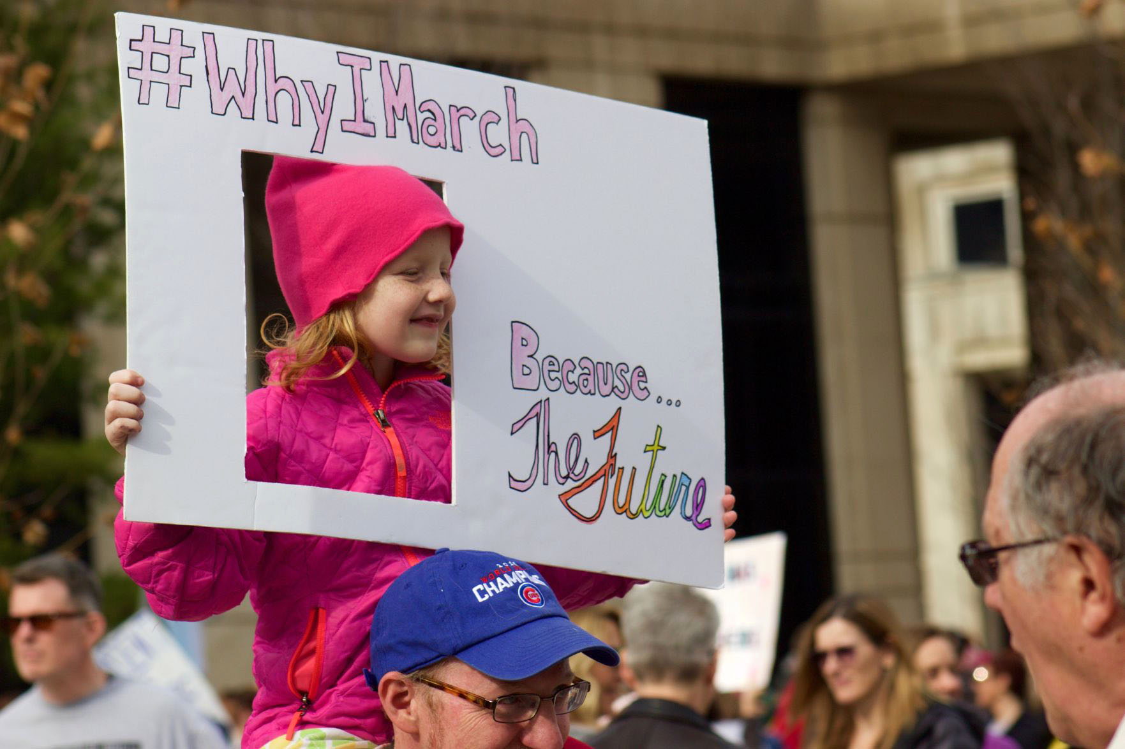
Take Informed Action
Type in the chat box some ways that you could encourage your students to demonstrate what they have learned and foster civic engagement.
Notes:
Talk about the C3 framework. Image from women’s march. Granny Haddock. Black Lives Matter. Pride Parade

Slide 35
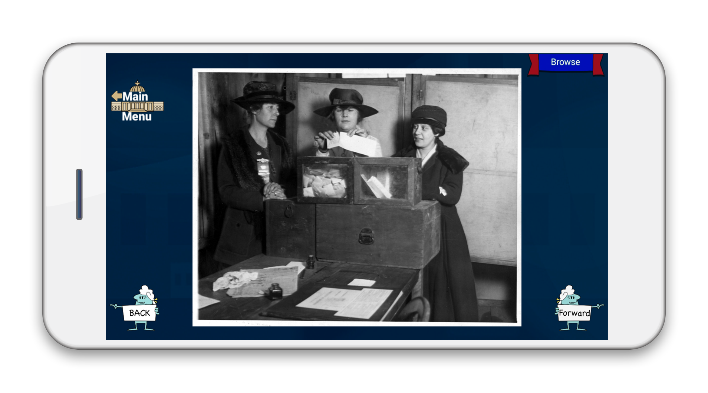
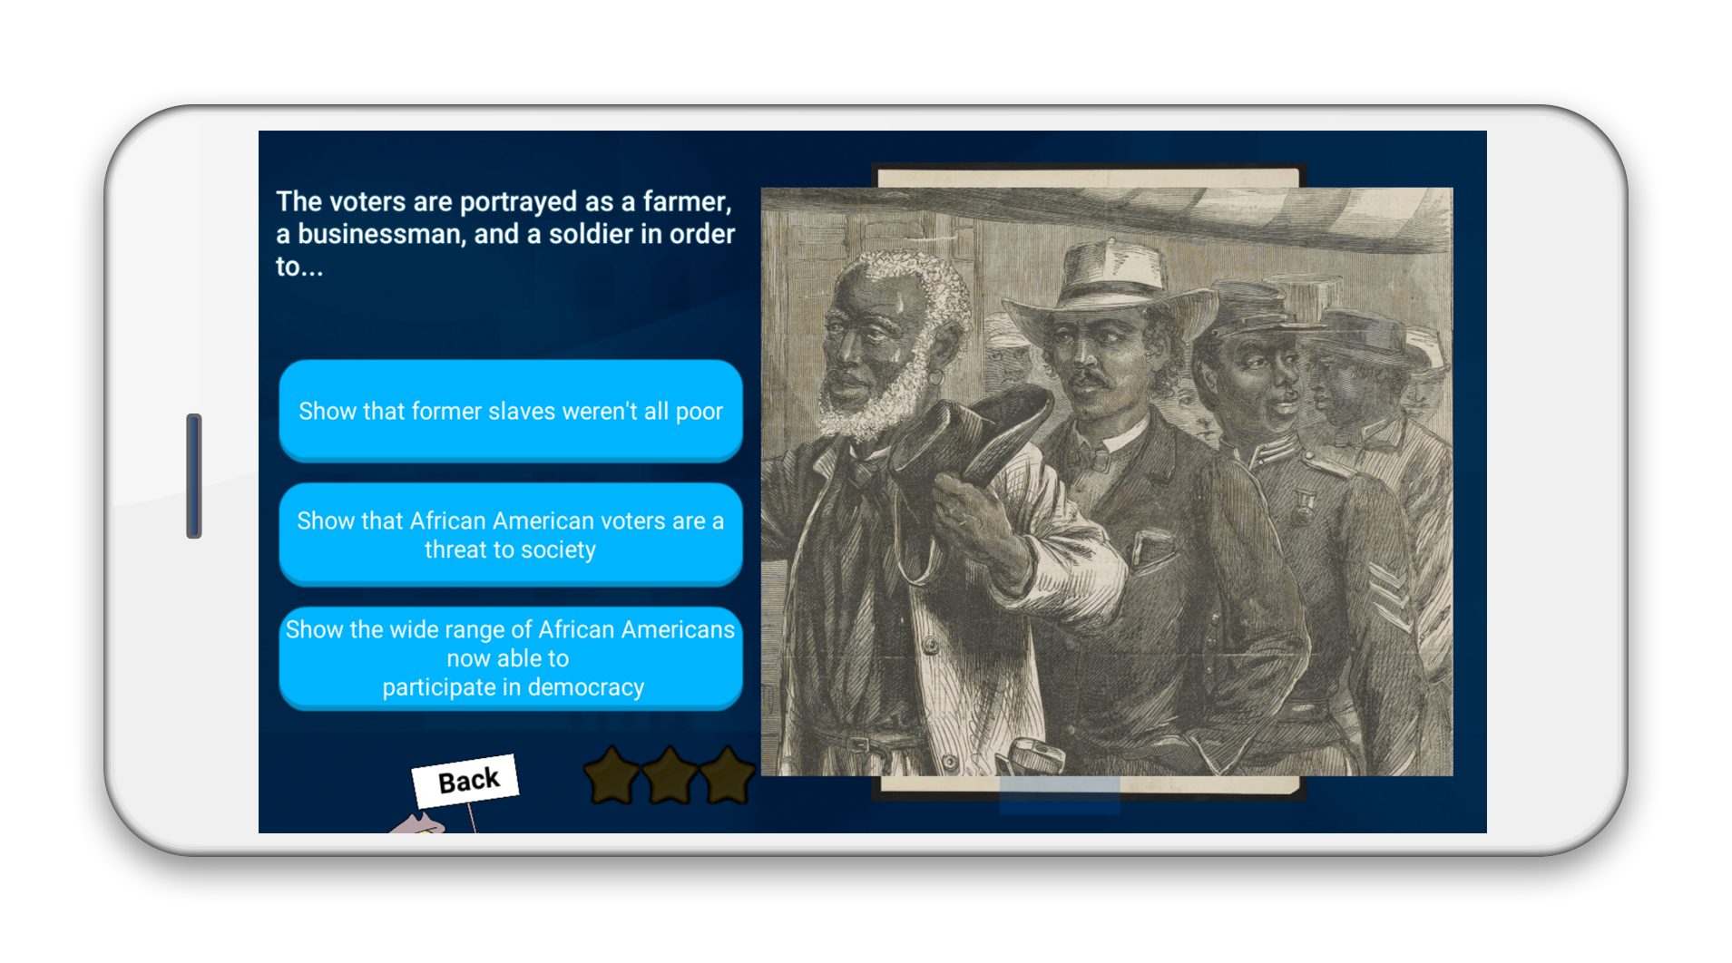
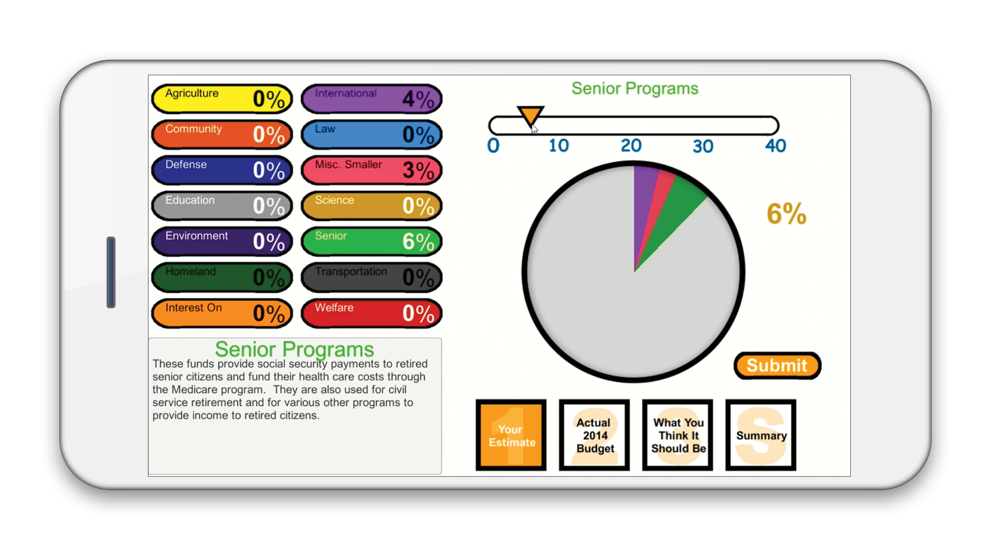



Uses inquiry-based analysis with:
Library of Congress Primary Sources
Interactive Skill Builders
Brief Videos
Content Assessed with:
Trivia Challenges
Knowledge Check
Mini Games
Primary Source Gallery
Documents for further in-class analysis.
Provides teachers with additional Library of Congress Teaching with Primary Sources (TPS) resources to extend content.
Available for free at

Slide 36
Effective Use of Primary Sources for Remote Teaching and Learning
Dr. Elizabeth R. Osborn @engagingcongres
Education Director, Indiana University Center on Representative Government
Jennifer Jolley, NBCT @jjolleymsd
Palm Bay Magnet High School, Melbourne, Florida
For more information, contact Dr. Elizabeth R. Osborn at eosborn@iu.edu
Notes:
Don’t need the award logo here since not primarily an EC webinar. Maybe should do the SML logo? Include date? June 25, 2020

